Slide 1
2018-24 Capital Improvement Program
Presented to the
Merrimack Town Council
December 7, 2017

Slide 2
CRF Funding (deposits)

Slide 3
2017-24 CRF Funding Projections (deposits)

Slide 4
2016-17 Projected CRF Funding (deposits)

Slide 5
Major Projects General Fund (expenses)

Slide 6
Major Projects Funding Sources (expenses)
Funding Source | 2017-18 | 2018-19 | 2019-20 | 2020-21 | 2021-22 | 2022-23 | 2023-24

Slide 7
Public Safety Complex
FY 18 - 24
Combine the Police and South Fire Station to one location
Police Station built in 1960 and 1975 as a two separate medical buildings
Remodeled in 1994 when it was donated to the Town for the Police Department
South Fire Station built in 1973 as a two bay garage
Remodeled in 1987 to include living quarters
Space needs study to happen in 2018-19
Findings to be presented to the Town Council Fall of 2018

Slide 8
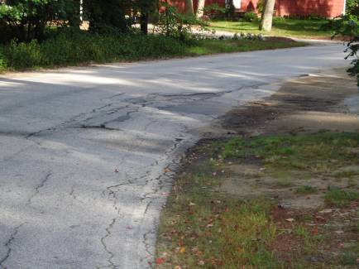
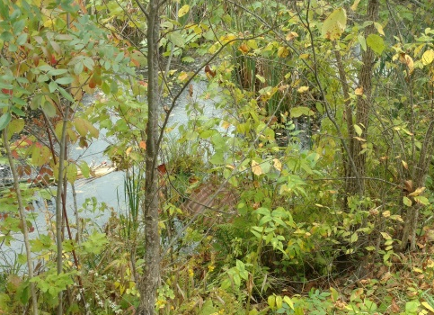
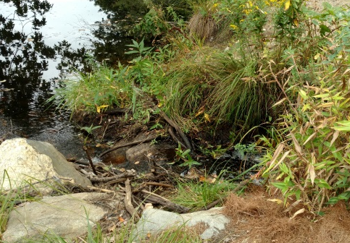
Stormwater Drainage Improvements
PWD CIP
FY 18 – 24
The Public Works Department maintains a prioritized list of drainage improvement projects. The list is updated twice each year. Projects are scored based on criteria in 4 subject areas – Public Health and Safety; Private Property Impacts; Public Property Impacts; and Secondary Factors. Projects are also classified as a Highway Division project, a Contractor project, or a combination of the two.
Anticipated projects for the FY 18/19 construction season are:
Brenda Lane pipe, outlet & riprap swale repair
South Baboosic Lake Road – 3 CMP’s Replacement
Thornton Road West – Culvert replacement & extension
Waterville Road – Culvert inspection & sink hole repair
Wilson Hill Road @ Town Line – Box Culvert Replacement
Woodland Drive Phase II Drainage Design
Town wide Basin Repairs
Roadway & Driveway Damage.
Deteriorating CMP Pipe
Culvert Extensions

Slide 9
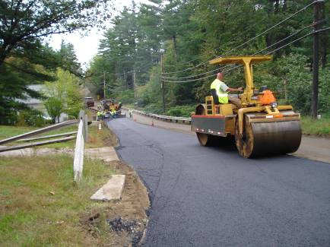
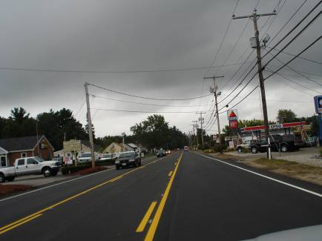
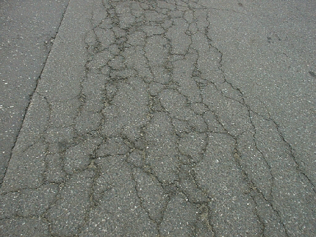
Paving / Infrastructure Improvements
PWD CIP
FY 18 - 24
The Public Works Department maintains over 475 roads totaling approximately 180 centerline miles. The Department uses a pavement management database in which physical road distresses for each road are tabulated to derive a PCI (Pavement Condition Index) for each public road. This data, along with traffic volumes, drainage/sewer projects, funding, and other factors are used to develop the paving/infrastructure improvement program for the year.
All or part of the following roads were paved during the past five years:
2017 – Amherst Rd had emulsion stabilization FDR in the top 4 inches, was reclaimed to a 12 inch depth, paved with ¾ inch Superpave base for a depth of 2 inches and a final top of ½” for a depth of 1.5 inch. Other roads paved included Meetinghouse Rd, County Rd, Lesa Dr, Dick Dr, Hamlet Circle, Dwyer St, Hitchinpost Lane, Draycoach Court
2016 – Manchester St, Bedford Rd, Naticook Rd, Camp Sargent Rd, Queens Way, Cynthia Rd, Lorraine Rd, Christina Rd, Meetinghouse Rd, Falcon Dr, Eagle Dr, Robin Ln, Sunnydale Dr, Wood St, Oak Ridge Ave, Bel Air Ave, McGaw Bridge Rd, Hoyt St, Griffin St, Jennifer Dr, Greeley St, Columbia Cir, Iris Dr, Erla Rd, Oxford St, Bancroft St, Newton St, Rutherford St, Den Ave, Bon Ave, Bigwood Dr, Dunrise Dr, Wallace Rd, JoEllen Dr (Roads paved with previous year surplus funds)
2015 – DW Highway, Baboosic Lake Rd, Wire Rd, Danforth Rd, Hassell Rd, Hutchinson Rd, Cummings Rd, Cowin Rd, School St, McElwain St, Bishop St, Hadley Rd, Trowbridge Rd, Ash Ln, Atherton Rd, John Ln, Wildcat Falls Rd, Edward Ln, Christopher Rd, Fearon Rd, Cavalier Country Ln, Mary Paul Ln, Valleyview Dr, Hancock Ln, Courtland Dr, Fairview Terrace, Ingham Rd, Morningside Ave, Sunset Dr, Dawn Ave, Highnoon Rd.
2014 – Hillside Terrace, Majestic Ln, Old Kings Rd, Regal Dr, Caron St, Herrick St, King St, Bryce Dr, Berry Ln, Mitchell St, Danforth Rd, Hassel Rd, Hutchinson Rd, Cummings Rd, Cowin Rd, Seaverns Bridge Rd, Coles Rock Rd, Cramer Hill Rd.
2013 – Patten Rd, Wilson Hill Rd, Turkey Hill Rd, Henry Clay Dr, John Tyler Rd, Drouin Way, Leblanc Ln, Davidson Ave, Piedmont Ave, Riverside Dr, Mast Rd
Paving Binder on Reclaimed Base.
New Lane Lines on Pavement.
Alligator Cracked Roadway.

Slide 10
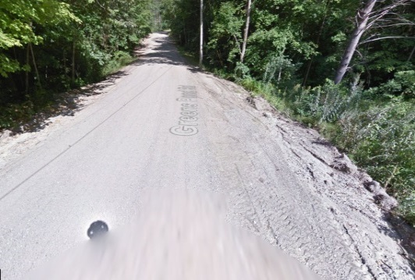
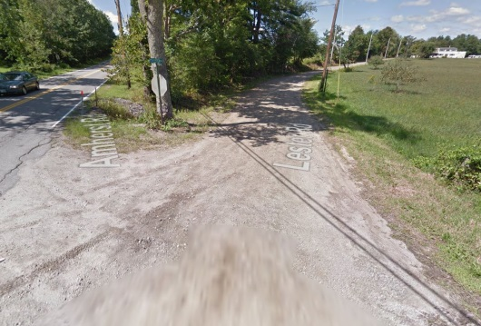
Paving / Infrastructure Improvements Gravel Roads
PWD CIP
FY 18 - 24
Merrimack has 16 gravel roads. Grading and reshaping the gravel roads uses approximately 300-400 man hours each year. Public Works proposes to systematically pave the gravel roads starting with the longer, higher traffic volume roads to reduce the maintenance burden. By constructing the paved roads with proper ditchlines, the effect of the added impervious area will be mitigated by treating the stormwater. The paved road has the added benefit of not being susceptible to erosion that contributes to silty runoff into neighboring waterbodies.
A secondary goal of this program is to eliminate the need to replace the motor grader. Currently, the existing 1997 grader is scheduled to be replaced in 2022 at an estimated cost of $250,000.
The roads initially targeted in this program are:
Greens Pond Road
Lester Drive
Fuller Mill Road
Current development projects are improving from gravel to paved on Old Blood Rd.
Greens Pond Rd – note erosion to the right
Lester Rd – will include realigning the “Y” intersection to a “ T” intersection

Slide 11
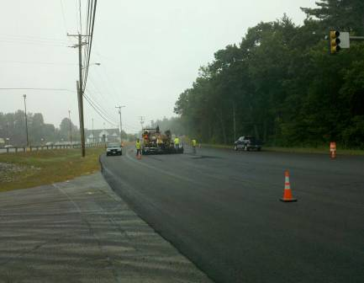
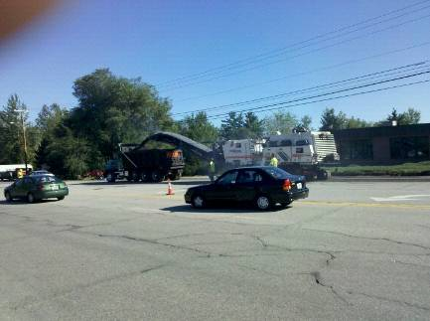
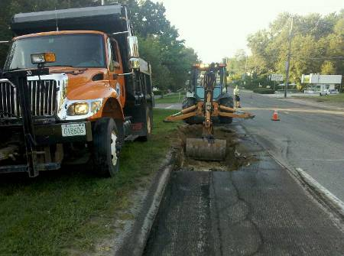
Paving Daniel Webster Highway
PWD CIP
FY 18 - 24
The Town of Merrimack is responsible for maintenance on the Class IV section of Daniel Webster Highway which runs from Greeley St to Bedford Rd, a distance of approximately 4.9 miles.
In 2011, the Town rehabilitated the section from Greeley St to the Chamberlain Bridge over the Souhegan River. In 2015, the Town repaved the section from the Chamberlain Bridge to Reeds Ferry Lumber. Both projects involved the expense of milling off the old wearing course of pavement and replacing with a new 1 ½” wearing course. The work planned in upcoming years includes crack sealing and bonded wearing courses in place of more expensive overlays as a more cost effective treatment aimed at keeping the road in good condition before more costly rehabilitation methods are needed.
The latest traffic counts along the corridor range from 14,200 to 19,000 AADT.
DW Highway Paving
DW Pavement Grinding
DW Repair Prior to Paving

Slide 12
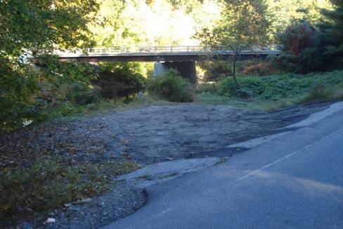
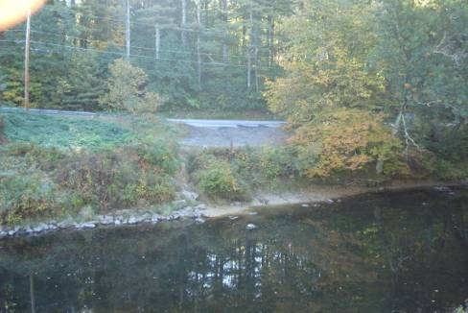
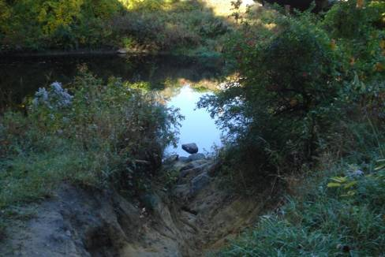
Seaverns Bridge Canoe Launch
PWD CIP
FY 18 - 24
The canoe launch at Seaverns Rd has experienced significant erosion of the Souhegan River bank, making it difficult for people to access the river with their canoes.
The project would seek to improve drainage in the area to prevent future problems, make parking access easier, and repair the river bank in a manner that allows access to the river by canoeists.
The project would be done in coordination with the Souhegan River Local Advisory Committee (SoRLAC).
Opportunity exists to work with the Conservation Commission to relocate the existing canoe launch to the Fields Farm conservation lands. Preliminary discussions between the Amherst and Merrimack Conservation Commission representatives, SoRLAC rep and Public Works staff have begun and will continue into the coming year.
View from Seaverns Bridge road looking west.
View from Seaverns Bridge looking east.
One of the large eroded areas.

Slide 13
Minor Projects (expenses)

Slide 14
Minor Project Continued (expenses)

Slide 15
Minor Project Continued (expenses)

Slide 16
User fee Minor Projects Cont. (expenses)

Slide 17
User fee Minor Projects Cont. (expenses)

Slide 18
Minor Projects Funding Sources

Slide 19
Summary of CRF

Slide 20
Questions/Comments

Slide 21
Supplemental Information
Major Project back-up Information for
2019-20 through 2023-24

Slide 22
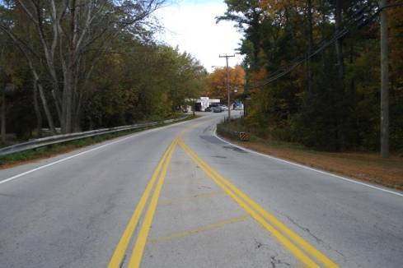
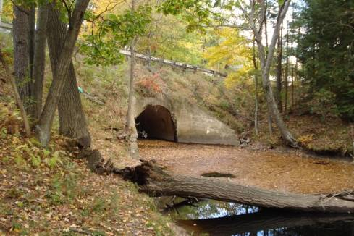
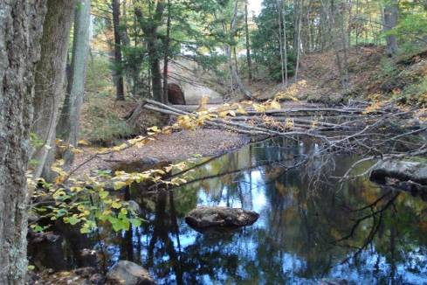
Bridge Replacement – US 3 (DW Highway)
PWD CIP
FY 18 – 24
US 3 bridge over Baboosic Brook (#118/135) was constructed in 1933. The concrete arch bridge has a 20 foot span. The US 3 bridge currently has a Federal Sufficiency Rating of 60.2% and a National Bridge Inventory Status of structurally deficient.
The bridge will be in the State Bridge Aid Program in which NHDOT pays for 80% of the cost of the project, while the Municipality pays the remaining 20%.
This bridge is the final road crossing of Baboosic Brook prior to its convergence with the Souhegan River. Hydraulic analysis of the brook performed by the Town’s bridge consultant shows that the current structure constricts flow, causing higher 50 and 100 year storm elevations upstream. Replacement of this structure will improve safety along the US 3 corridor by having a wider road and sidewalks, and will have the added benefit of allowing the McGaw Bridge Rd and Bedford Rd bridges to be constructed at lower elevations due to the reduced flood elevation.
The 2015 AADT (Average Annual Daily Traffic) for this bridge is 14197. The predicted AADT for 2032 is 19,694. Construction is expected to occur in 2022/2023.
US 3 looking north.
US 3 bridge, downstream side.
Bank erosion from high velocity flows through current structure..

Slide 23
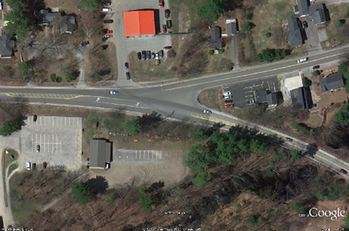
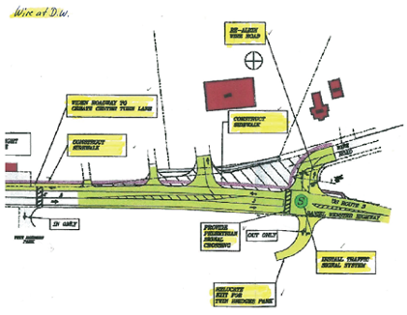
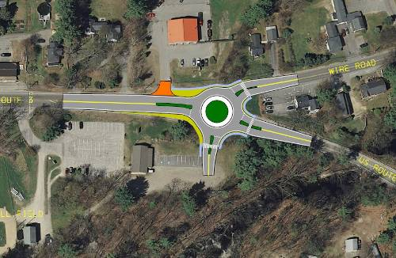
Wire Road Intersection Improvements
PWD CIP
FY 18 - 24
The Wire Rd intersection with Daniel Webster Highway is poorly aligned. This project will improve safety by realigning the intersection.
There have been 19 accidents at the existing intersection from the period of January 1, 2006 to September 18, 2012. Of those, fourteen involved property damage, four resulted in personal injury, one involved a school bus, and one was uninvestigated.
Various options are being considered: Sharp curve to align Wire road at a 90 degree angle to Daniel Webster Highway with traffic signals or stop sign (depending on the signal warrant study), or a roundabout intersection. As part of the project, a new point of ingress/egress to the Twin Bridge Park/Bise Field/MYA Building facilities that would improve safety versus the existing drive across from Church St.
The project is currently being proposed in the NH DOT 10 year plan and payment will be an 80/20 split (Federal $/Town $). Construction of the intersection is scheduled for 2026/2027.
Aerial View of Wire Road/DW Highway Intersection.
Signalized Intersection.
Roundabout Intersection.

Slide 24
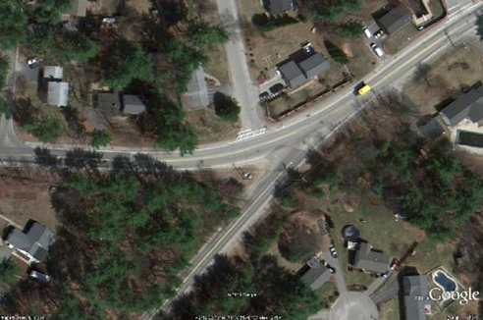
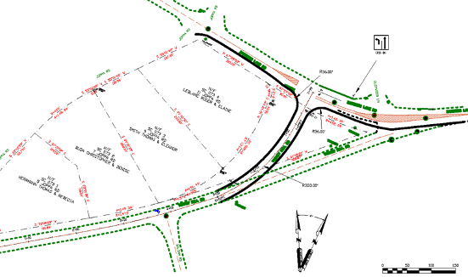
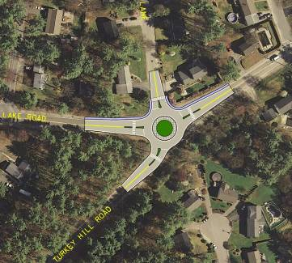
Turkey Hill Rd Intersection Improvements
PWD CIP
FY 18 - 24
The Turkey Hill Rd intersection with Baboosic Lake Road is poorly aligned. This project will improve safety by realigning the intersection.
There have been 15 accidents at the existing intersection from the period of January 1, 2005 to September 18, 2012. Of those, twelve involved property damage, four resulted in personal injury, and one was uninvestigated (parties came to PD to report accident).
Two design concepts are being considered: Curve the end of Turkey Hill Rd to align at a 90 degree angle to Baboosic Lake Rd, or a roundabout intersection.
Engineering for the project will be performed by Public Works staff. Construction is anticipated in 2019-20.
Aerial View of Turkey Hill Rd/ Baboosic Lake Rd Intersection.
Curved Rd w/Stop Intersection
Roundabout Intersection.

Slide 25
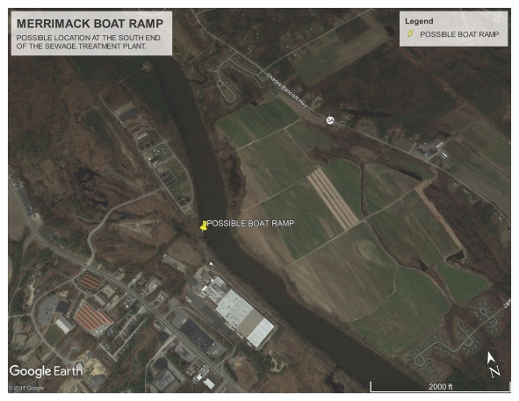
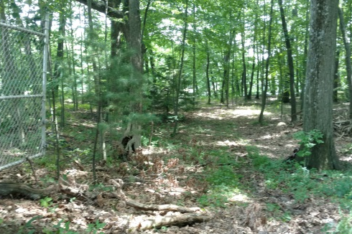
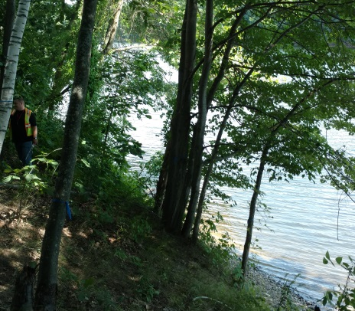
Merrimack River Boat Ramp Access Improvement
PWD CIP
FY 18 - 24
Access to the Merrimack River for larger, recreational boat use is currently difficult or not possible due to the limitations with the Griffin Street boat ramp and ramp access. The State Fish and Game Department has funds to provide boat ramp improvements. Due to the difficult access at Griffin Street Public Works is exploring another option utilizing the land south of the Wastewater Treatment Facility.
The State Fish and Game Dept. can provide 50/50 matching funding up to $200,000 to the qualifying applicants. Access across the railroad tracks in this area is much better. The fence line along the sewage treatment plant will need to be moved or relocated. Extensive grading will need to be done to get to the water. Applications are on a 2 year cycle and will be accepted in 2018.
Aerial View
Proposed access & ramp area

Slide 26
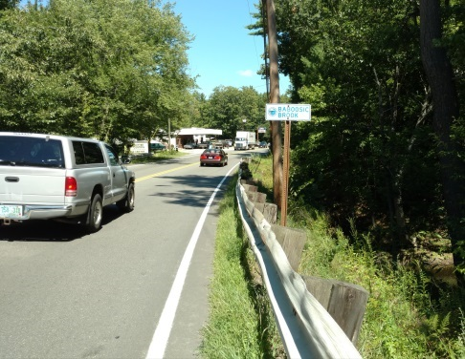
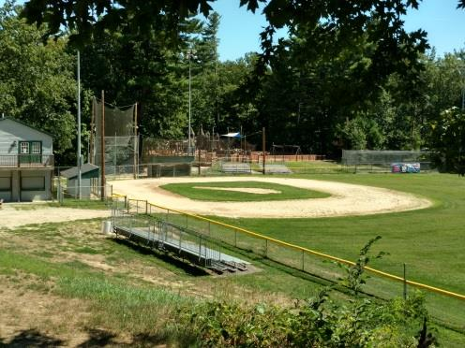
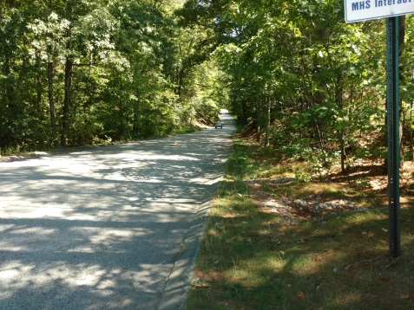
Sidewalk Enhancement – DW Highway and Woodbury St
PWD CIP
FY 18 - 24
The Town of Merrimack has applied for a grant opportunity through FHWA/NHDOT to construct sidewalks. This grant will allow the Town of Merrimack to achieve sidewalk priorities #2, #3 and #6 as outlined in the 2009 Town Center Pedestrian and Trail Master Plan. The goal is to provide a safe and inviting access for the Town residents and visitors to patronize local business, access parks, municipal buildings, schools and other key destinations in the Town Center Area.
The first section consists of 1,400 feet along DW Highway connecting Church St to Twin Bridge Rd. This section will tie the Library, Adult Community Center to the MYA Building at Twin Bridge Park and Kids Kove Playground. In conjunction with the Wire Rd intersection upgrades and the US 3 bridge replacement, this section of sidewalk will make the area safer for all pedestrians.
The second part of this grant will install 1,300 feet of sidewalk along Woodbury St connecting the High School to DW Highway and the Souhegan River Trail Project. This will complete to loop to and from Watson Park and Merrimack High School.
Preliminary design will begin early 2018 with construction expected for 2020.
Crossing at Baboosic Brook
Twin Bridge Park & Kids Kove
Woodbury St Sidewalk

Slide 27
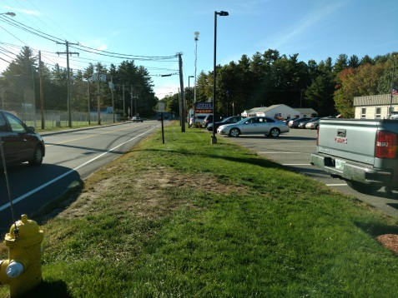
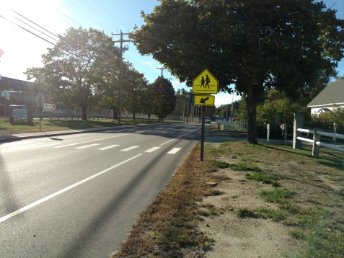
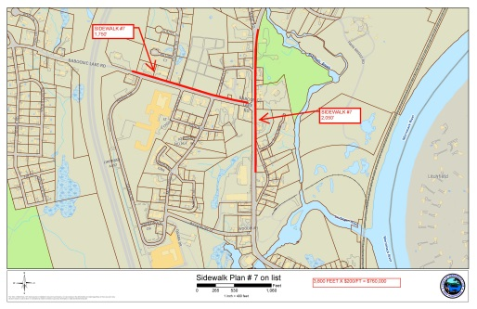
Sidewalk Enhancement – DW Hwy. & Baboosic Lake Rd
PWD CIP
FY 18 - 24
The Town Center Pedestrian and Trail Master Plan has outlined many areas within the Town Center that are in need of sidewalks. Part of Priority #7 that is located on Baboosic Lake Rd identifies the need to constructed a sidewalk on the north side of the road between the end of the sidewalk at the Library to an area just past the Police Station.
Constructing this section of sidewalk will connect the residents living north of Baboosic Lake Rd to the schools and Town facilities south of Baboosic Lake Rd. This project will also allow for the cross walks on Baboosic Lake Rd to be placed in the appropriate areas for safe pedestrian access. This section of sidewalk will provide direct access to the Library, Adult Community Center and will tie into the previous Sidewalk project. This allows pedestrians to gain access to the park and retail establishments without having to cross Baboosic Lake Rd.
Priority #7 on the plan also proposes to connect sidewalks on the east side of DW Highway between Loop Rd to Twin Bridge Park.
Public Works would look to fund 80% of this project through FHWA Transportation Alternatives Program funds. Application will be made in the year 2018.
Baboosic Lake Rd by Police Station
Crosswalk from school to nothing
DW Highway by Twin Bridge Park

Slide 28
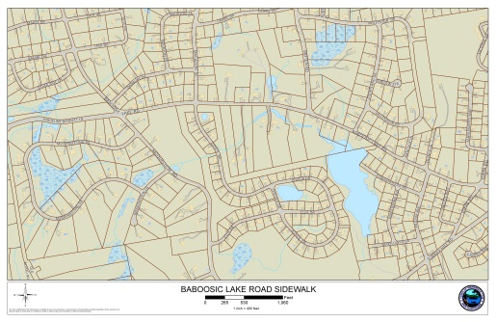
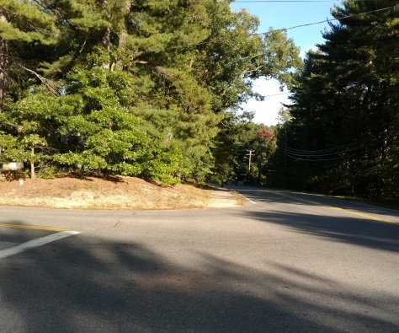
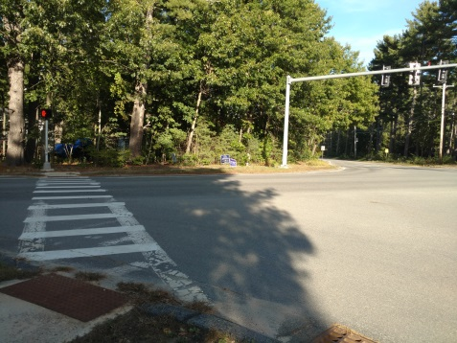
Sidewalks – Baboosic Lake Rd to Middle School
PWD CIP
FY 18 - 24
The 2013 Updated Master Plan has recommended as one of the most important elements under the Transportation Plan Recommendations that the Town of Merrimack continue to develop a town-wide Pedestrian and Bicycle Plan. To coincide with that they also recommend establishing a Capital Reserve Fund for sidewalk and pedestrian way construction.
As a first phase of this project the proposal is to construction of a sidewalk along Baboosic Lake Rd. Ultimately, this will connect the Elementary and Upper Elementary Schools to the Middle School. More importantly it will give safe and adequate access along a very busy roadway and it will help to connect the area east of the FE Everett Highway to the area on the West side of the FE Everett Highway.
This stretch of sidewalk is approximately 5,250 feet long. It will connect from the existing sidewalk that ends at Joppa Hill Rd to the intersection with Madeline Bennett Ln.
Public Works would look to fund 80% of this project through FHWA Transportation Alternatives Program funds. Applications will be made for the 2020 cycle.
Proposed Sidewalk Location
Tie into the end of sidewalk at Joppa Rd
Tie into crosswalk at Madeline Bennett Ln to the School

Slide 29
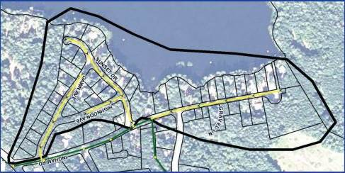
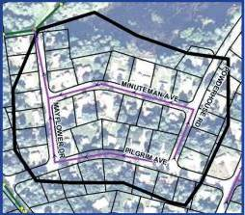
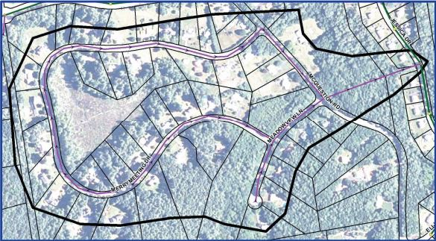
Sewer Extension Project – Master Plan
PWD CIP
FY 18 - 24
The Town commissioned an updated sewer master plan in 2013. This plan replaced previous plans that were created in 1977 and 1990. The top priority project (Naticook Lake East Collector Sewers) was completed in 2015.
The Master Plan ranks projects based on a number of factors including impediments to onsite sewage treatment, access to existing collection system, environmental concerns, consistency with community master plan and unit costs.
The Mayflower Dr Collector Sewers project (MP Priority #3) would allow for approximately 43 homes to hook up to sewer. The project involves constructing approximately 2,400 linear feet of 8 inch diameter collector sewer. The roads in the area are in poor condition (Powderhouse and Minuteman – PCI of 31; Pilgrim and Mayflower – PCI of 54 and 54).
The McQuestion Rd North Collector Sewers project (MP Priority #2) would allow for approximately 44 homes to hook up to sewer. The project involves constructing approximately 6,400 linear feet of 8 inch diameter collector sewer in parts of McQuestion Rd, Meadow View Ln and Merrymeeting Dr.
Naticook Lake East Collector.
Mayflower Dr Collector.
McQuestion Rd Collector.

Slide 30
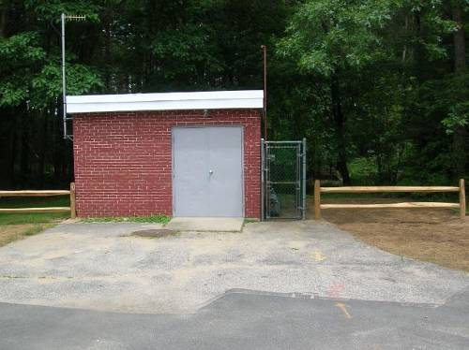

Sewer Relocation under Everett Turnpike
(FKA Executive Park Drive Pump Station)
PWD CIP
FY 18 - 24
NHDOT is working toward widening the two-lane sections of the F.E.E.T. in Merrimack – as part of that project they are replacing the concrete box culvert that carries Naticook Brook and our sewer pipe. By coordinating our project with the NHDOT work we can provide a new crossing under the turnpike outside of the brook at a cost similar to the pump station concept. The gravity pipe will eliminate the maintenance requirements associated with a pump station. Estimated cost to construct this project independent of the NHDOT work were $3M. Previous project text is maintained below.
This is a new pump station that will replace an inaccessible section of cross country sewer that was installed in the 1980’s as a temporary solution to sewer the Executive Park Dr area as well as the sewer system located on Turkey Hill Rd.(Olympic Village), Bon Ave., JoEleen Dr., Forsythia Ln., and Bigwood Dr. The sewer in question runs under the F.E. Everett Turnpike to the Rt. 3 sewer near King Kone Ice Cream. Flow would be pumped to the 24” sewer line on Continental Blvd. This pump station is recommended in the 2013 Sewer Master Plan.
In addition, the existing pipe capacity would be exceeded if Projects 27, 29, 30 and 34 were built as recommended in the Sewer Master Plan.
The estimated cost for this station including engineering is $1,300,000. Design is estimated at $156,000 and is recommended in FY 18/19.

Slide 31
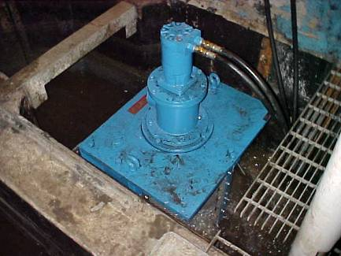
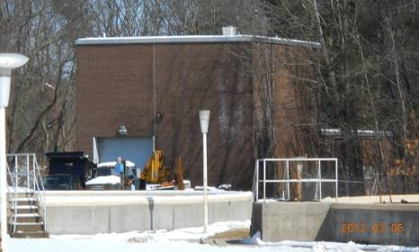
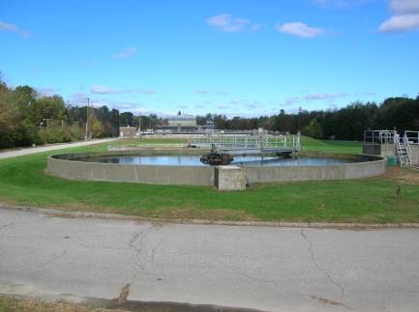
Phase III Wastewater Facility Improvements
PWD CIP
FY 18 - 24
The Phase III Upgrade will replace the remaining 47-year-old equipment at the Wastewater Treatment Facility that has reached the end of its useful life. Loans for the Interceptor Rehabilitation and Dewatering Projects will be retired prior to the start of payments for this project. This is the final phase of plant upgrades unless there are new EPA requirements in our next permit.
Highlights of improvements to the Wastewater Treatment Facility in Phase III include: replacement of collectors on the secondary clarifiers, one primary clarifier, complete rehabilitation of the Main Pump Station (new pumps, motors, controls, MCC replacement, coatings, lighting, and ancillary support systems) including a new raw wastewater screening plant and wash press to replace the original raw wastewater grinder, sludge pump and controls and piping replacement for primary sludge, emergency backup generator replacements, waste activated sludge pumps, lighting replacements, diversion tank upgrades, underground piping replacement, repaving plant roadways, SCADA related improvements, code related improvements. A complete list of equipment and costs will be developed in the preliminary engineering (design) report.
Project scope and costs will be defined in the Preliminary Design Report (PDR) undertaken in FY 17/18. Estimated cost is $10,000,000 including engineering that includes funding from the CRF for the PDR and $12.6 MM from NHDES SRF low interest loan that includes the pump stations.
PWD proposes to have this project funded beginning in FY 17/18 and 19 for the PDR and in FY 2019-20 for the project including the pump station project.
Original Raw Wastewater Solids Grinder 1970
Main Pump Station 1970
One of 3 Secondary Clarifiers (1970)

Slide 32
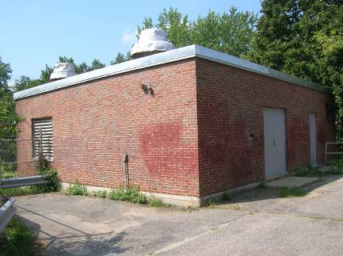
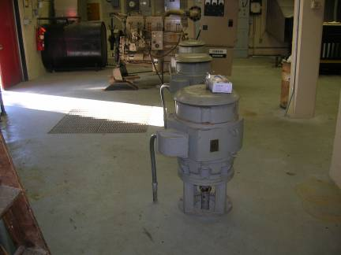
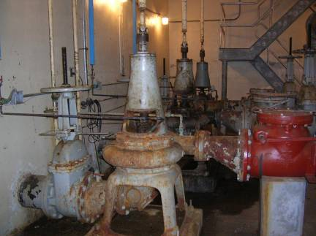
Thornton's Ferry & Souhegan Pump Station Improvements
PWD CIP
FY 18 - 24
The Thornton's Ferry and Souhegan pump stations are the two largest pump stations in the sewer collection system. They pump approximately 75% of all residential and commercial wastewater to the treatment facility. Both stations are 43 years old. These stations are identical in appearance and construction with larger pumps located in the Thornton's Ferry station. Estimated cost of these improvements is $3,000,000.
Improvements include: new pumps, motors, and controls, new solids grinders, new flow meters, replace piping and valves, dry pit recoating and painting, wet well coating and painting, replacement of doors and frames, replacement of force mains or lining to gravity sewer, HVAC upgrades, bypass pumping, code related improvements.
Failures at either station would cause loss of service and environmental and health risks as well as potential fines by both NHDES and EPA.
The Preliminary Design Report (PDR) will be undertaken in FY 17/18 and FY 18/19 as part of the Phase III project.
PWD proposes to have this project funded in FY 2019-20 in conjunction with the Phase III project.
Souhegan pump station 1972
Pump motors to be replaced
Pumps to be replaced

