Slide 1
2024-30 Capital Improvement Program
Presented to the
Merrimack Town Council
November 2, 2023

Slide 2
Brief overview of the Capital Improvement Plan Objectives
Along with Charter Article 8-9, the Planning Board was directed by the 1984 Town Meeting to prepare and maintain a six-year capital improvements program ("CIP") to aid with the capital needs of the annual budget. Related to the preparation of this CIP, RSA 674:7 requires municipal departments, the school board, the library, and the water district to submit statements of proposed capital expenditures to the Planning Board. For CIP purposes, the Planning Board defines "capital expenditure" as the purchase, construction, or improvement of land, buildings, infrastructure, or equipment having an associated cost of $100,000 or more and an estimated useful life of at least seven years.
Major Projects - Depicts the annual expenditures or cash flow for proposed projects, which will cost $100,000 or more and will be evaluated by the Planning Board. Regardless of the related cost, the Planning Board is generally not interested in the purchase of equipment. Its objective is to evaluate proposed building and infrastructure projects on the basis of the Master Plan and the Build-Out Study.
Minor Projects - Depicts the annual expenditures or cash flow for proposed projects, which will cost at least $10,000 but will not be subject to Planning Board evaluation.

Slide 3
2024-30 CRF Funding Projections (deposits)

Slide 4
2024-25 Projected CRF Funding (deposits)

Slide 5
Major Projects General Fund (expenses)

Slide 6
Major Projects General Fund (expenses)

Slide 7
Safety Complex
The replacement of the Central Fire Station and the Police Station are due to outgrowing the current facilities. The two departments have completed a space needs study and have a rough sketch of the total space needed for the new Safety Complex.
Station 1 originally constructed in 1960 as a two story fire station with 3 bays. This station was expanded in 1996 for additional 3 bays for a total of 6 bays.
The Police Station is made up of two individual buildings that have a common entry way built when the police department was relocated there in 1994. The first was constructed in 1960 and the second was built in 1975.
Merrimack has had steady growth since these facilities were first opened. Some of the latest growth includes: The Merrimack Premium Outlet Mall, Nanocomp, Laidlaw Freight, Gilbert Crossing and additional apartments in the southern end of town. In addition with the age of these facilities it is hard to expand to due the fact that both of these locations are in Residential areas and there is no availabe land surrounding these facilities. The construction of a new Public Safety Complex would allow the town's first responders to be colocated in an area of town where access to the major roads is easily available.

Slide 9
South Fire Station Renovations
The South Fire Station was originally constructed in 1973 as a two bay garage to house only fire apparatus. This station was expanded in 1987 to include living quarters for 3 Fire personal. The current station does not have adequate facilities to support male and female responders.
In addition with the age of this facility it is hard to expand to due the fact that this location is in a Residential area and there is no available land surrounding the facility.
Merrimack has had steady growth since this facility was first opened. Some of the latest growth includes: The Merrimack Premium Outlet Mall, Huntsman, Laidlaw Freight, and future build out in the North/South end of the community.

Slide 10
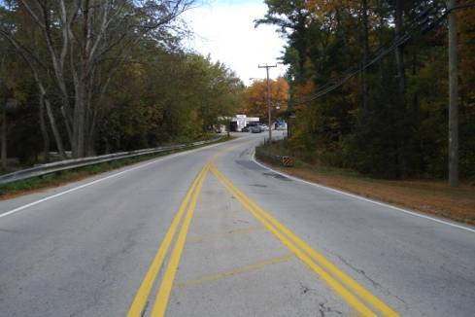
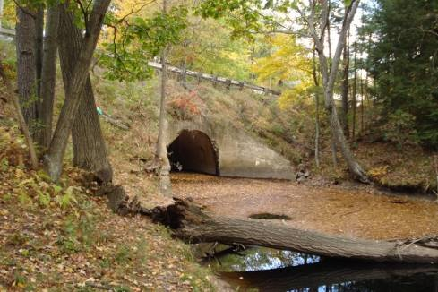
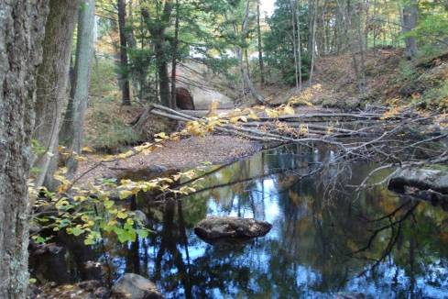
Bridge Replacement – US 3 (DW Highway)
PWD CIP
FY 24 – 30
US 3 bridge over Baboosic Brook (#118/135) was constructed in 1933. The concrete arch bridge has a 20 foot span. The US 3 bridge currently has a Federal Sufficiency Rating of 60% and a National Bridge Inventory Status of structurally deficient. The bridge is categorized as a red list bridge.
The bridge will be in the State Bridge Aid Program in which NHDOT pays for 80% of the cost of the project, while the Municipality pays the remaining 20%. The costs on this project exceed available funding from NHDOT at this time so the Town is seeking to augment the funding through the FEMA Bric Program.
This bridge is the final road crossing of Baboosic Brook prior to its convergence with the Souhegan River. Hydraulic analysis of the brook performed by the Town’s bridge consultant shows that the current structure constricts flow, causing higher 50 and 100 year storm elevations upstream. Replacement of this structure will improve safety along the US 3 corridor by having a wider road and sidewalks, and will have the added benefit of allowing the McGaw Bridge Rd and Bedford Rd bridges to be constructed at lower elevations due to the reduced flood elevation.
The 2019 AADT (Average Annual Daily Traffic) for this bridge is 14,565. Construction is expected to begin in 2025.
US 3 looking north.
US 3 bridge, downstream side.
Bank erosion from high velocity flows through current structure..

Slide 11
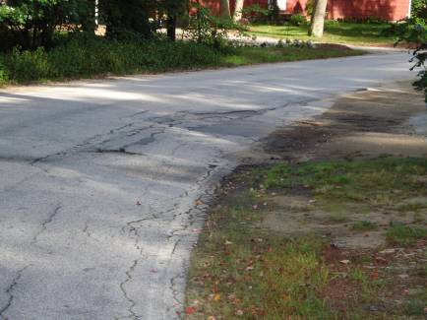
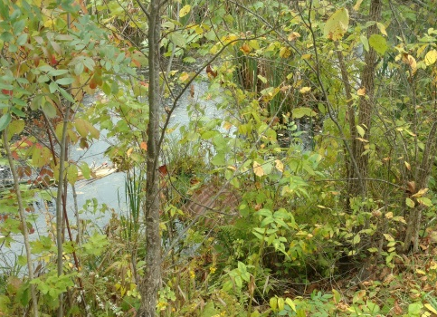
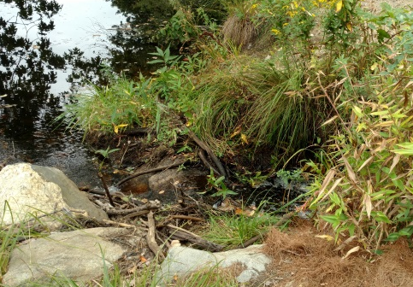
Stormwater Drainage Improvements
PWD CIP
FY 24 – 30
The Public Works Department maintains a prioritized list of drainage improvement projects. The list is updated twice each year. Projects are scored based on criteria in 4 subject areas – Public Health and Safety; Private Property Impacts; Public Property Impacts; and Secondary Factors. Projects are also classified as a Highway Division project, a Contractor project, or a combination of the two.
The Town utilizes Public Works forces or contracted serviced to maintain and improve the existing drainage infrastructure through this program. Recent projects completed include:
CWSRF Funds for study of Baboosic Lake Area – Pine Knoll Shores
Lantern Lane & Nutmeg area
Belmont/Country Club
Gail Road and Jay Road intersection
Amherst Road
Clay Street and surrounding subdivision
Roadway & Driveway Damage.
Deteriorating CMP Pipe
Culvert Extensions

Slide 12
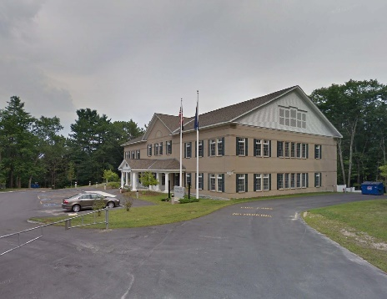
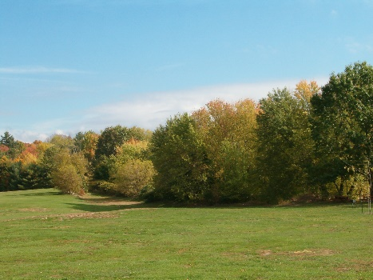
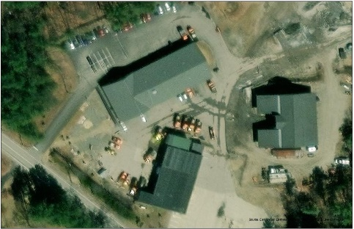
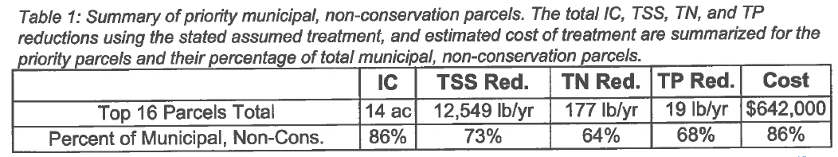
Install bmp’s on existing town owned facilities
PWD CIP
FY 24 – 30
Objective is to improve the water quality by reducing the amount of Phosphorus, Hydrocarbons and Metals impairments that enter the surface waters from Town owned properties. This is accomplished by installing structural and non-structural BMP’s. Town owned properties include properties, buildings, ball fields, roads and drainage infrastructures. The requirements come under the EPA’s Municipal Separate Storm Sewer System (MS4) permit that was issued to the Town effective on July 1, 2018.
Under section 2.3.6.e., an inventory and priority ranking of permittee-owned property and infrastructure that could be retrofitted with BMP’s designed to reduce the frequency, volume and pollutant loads of stormwater shall be completed within the first 4 years.
EPA developed a priority list of properties and estimated costs, shown in Table 1 below.
Merrimack District Court – Bishop Street
Watson Park
Highway Garage

Slide 13
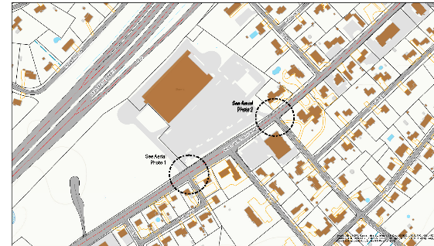
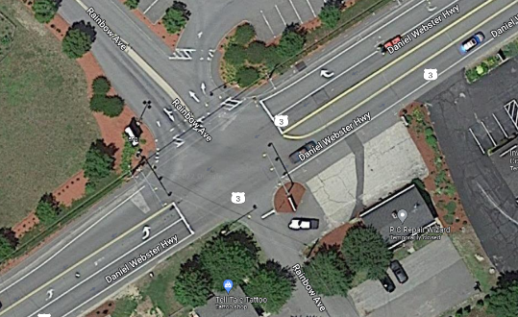
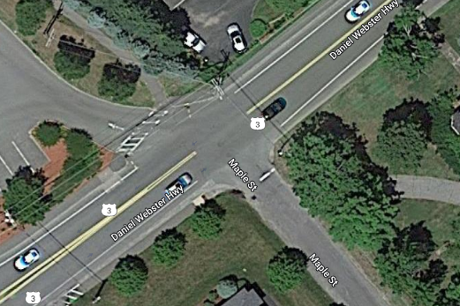
Dwh crosswalk @ shaws
PWD CIP
FY 24 – 30
On July 21, 2022 the proposal was brought before the Town Highway Safety Committee regarding the Safety of the Pedestrians trying to cross Daniel Webster Highway in the location of the Shaw’s store. The Committee decided unanimously that this project was a safety issue and that a plan be formulated for the implementation of what will be needed along this stretch of DWH.
There are 2 possible locations one being at the existing stop light at Rainbow Ave. The other possibility is to have an independent crosswalk at Maple Street which is across from the Shaw’s plaza right turn in slip road. There is a section of sidewalk that is on DWH that is across from the plaza within this location.
This should be considered to be constructed if the empty lot next to the existing Shaw’s building is built upon.
Daniel Webster Highway – MYA
DWH@ existing stop light @ Rainbow
DWH at Shaw’s slip entrance & Maple

Slide 14
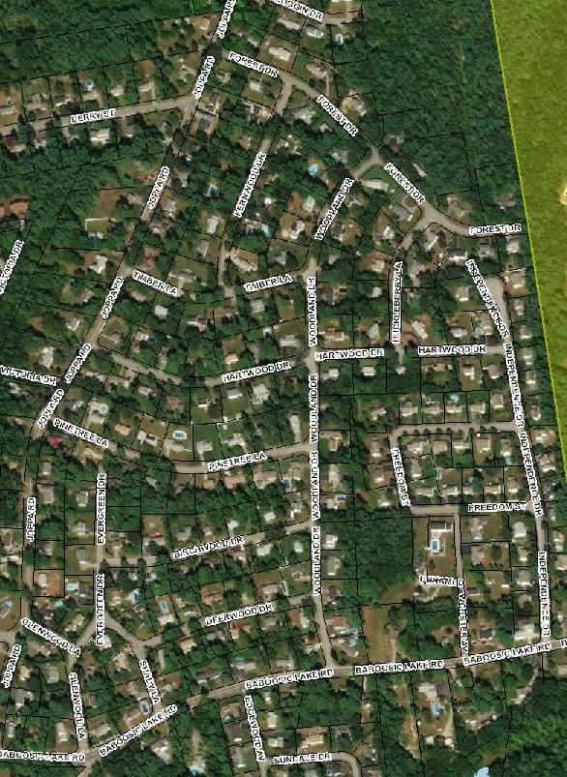
woodland drive – phase ii drainage improvements
Phase II of the Woodland Drive area drainage improvements will improve sections of the following roads:
Timber Lane, completed 2023
Fernwood Drive, completed 2023
Hartwood Drive,
Forest Drive,
Pinetree Lane,
Birchwood Drive,
Deerwood Drive

Slide 15
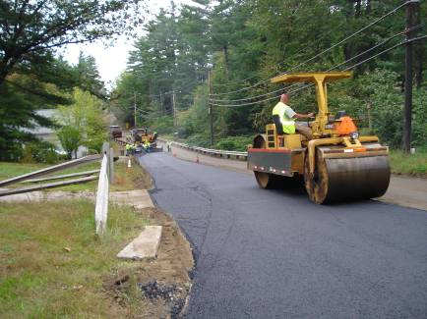
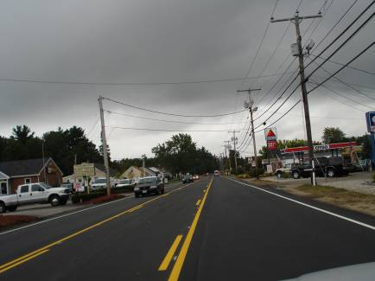
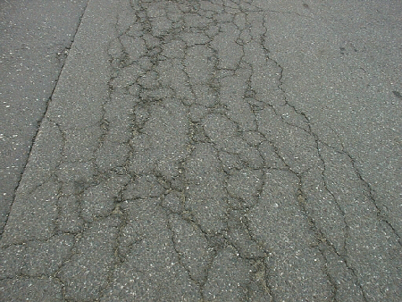
Paving / Infrastructure Improvements
PWD CIP
FY 24– 30
The Public Works Department maintains over 475 roads totaling approximately 180 centerline miles. The Department uses a pavement management database in which physical road distresses for each road are tabulated to derive a PCI (Pavement Condition Index) for each public road. This data, along with traffic volumes, drainage/sewer projects, funding, and other factors are used to develop the paving/infrastructure improvement program for the year.
All or part of the following roads were paved during the past two years:
2023 – Pearson Road and South Baboosic Lake Road had emulsion stabilization FDR in the top 4 inches, was reclaimed to an 8 to 12 inch depth, paved with ¾ inch Superpave base for a depth of 2 inches and a final top of ½” for a depth of 1.5 inch. Other roads paved included Hallets Way, Pilgrim Ave, Mayflower Road, Minuteman Ave., Powderhouse Road, Mallard Point Phase II, Woodward Road, Beebe Lane and Colman Path. The crack sealing was also completed for many of the roads not recently paved.
2022 – Amherst Road had emulsion stabilization FDR in the top 4 inches, was reclaimed to an 8 to 12 inch depth, paved with ¾ inch Superpave base for a depth of 2 inches and a final top of ½” for a depth of 1.5 inch. Turkey Hill Road was reconstructed from the roundabout to McQuestion Road. Other roads paved included Joppa Road Extension, Naticook Road and Baboosic Lake Road.
Paving Binder on Reclaimed Base.
New Ln Lines on Pavement.
Alligator Cracked Roadway.

Slide 16
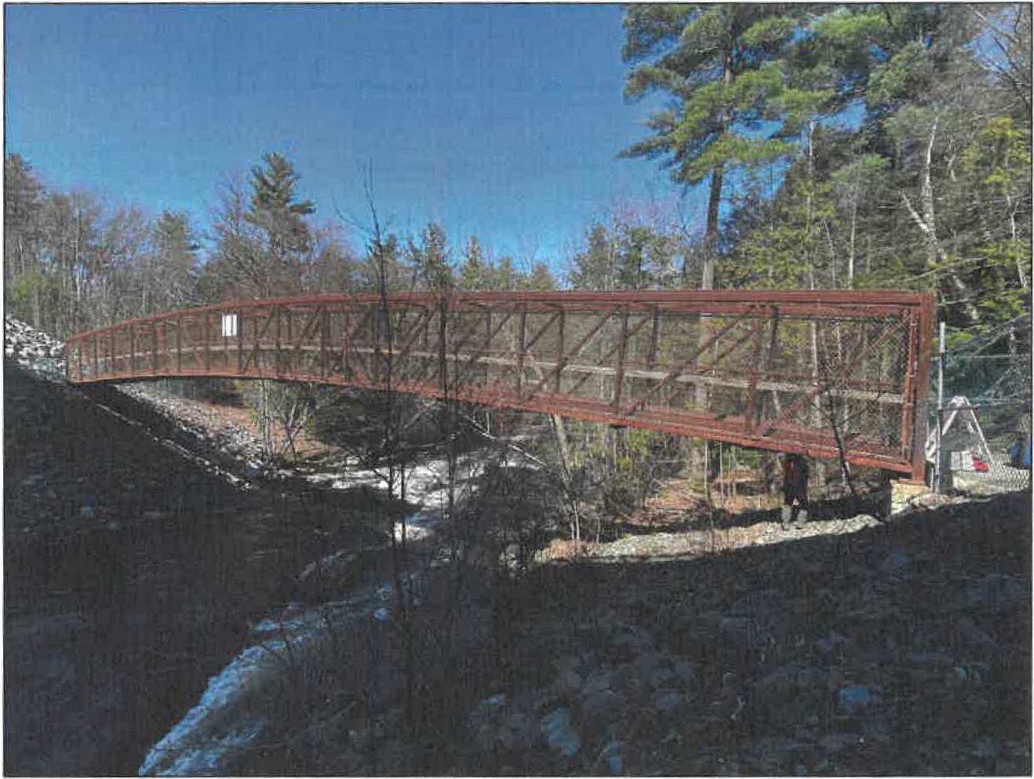
Pedestrian bridge over souhegan river
PWD CIP
FY 24 – 30
The existing Pedestrian Bridge is a single span 134 foot long and 6 foot wide prefabricated High Truss Bridge manufactured by Continental Custom Bridge Company. The superstructure was acquired from the City of Portsmouth and was put into place on cast-in-place concrete abutments in 2011.
The bridge is located just easterly from the FE Everett Turnpike and has deteriorated due to the moisture from the river and the salt sprat from the FEET. The bridge has been an invaluable resource connecting the Wildcat Falls Conservation Area extensive trail system together with the residents.
In the fall of 2019 NH DOT bridge inspectors determined there were structural defects in the pedestrian bridge crossing over the Souhegan River. The decision was made to close the bridge on April 24, 2020, after our hired structural engineering firm performed a detailed structural analysis.
The bridge is in the NH DOT Draft Ten Year Plan that is waiting for acceptance in 2022. Engineering and ROW is expected to begin in 2027 and construction to follow in 2032.

Slide 17
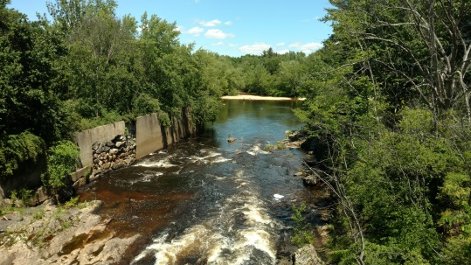
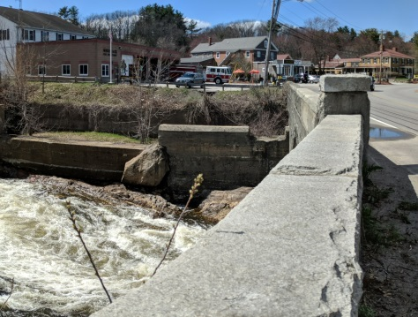
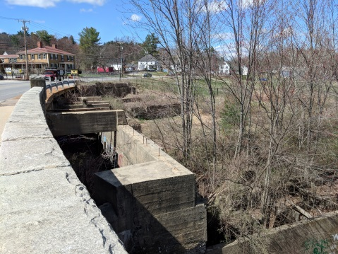
Bridge Repair – Chamberlain Bridge Over Souhegan River
(DW Highway)
PWD CIP
FY 24 – 30
Chamberlain Bridge over the Souhegan River on Daniel Webster Highway (#116/120) was constructed in 1921 and Reconstructed in 1934. The stone/concrete arch bridge has a 2 arches and a total span of 113 feet. The US 3 bridge currently has a Federal Sufficiency Rating of 28% and a National Bridge Inventory Status of structurally deficient. The bridge has been categorized as a red list bridge.
The bridge is expected to be in the State Bridge Aid Program in which NHDOT pays for 80% of the cost of the project, while the Municipality pays the remaining 20%. Currently the State is not accepting new applications.
This bridge has a maximum span of 60 feet over the Souhegan River. The length of the bridge is a total of 113 feet and 42 feet wide with a curb to curb travel lane width of 32 feet. Part of the repairs will be completed within the Souhegan River Trail project. The Main Arch will be rehabilitated including masonry repointing and some concrete patching.
The 2019 AADT (Average Annual Daily Traffic) for this bridge is 13,596.
View of Souhegan River –
Down stream.
Chamberlain Bridge, upstream side.
Canal for Multi-Use Path

Slide 18
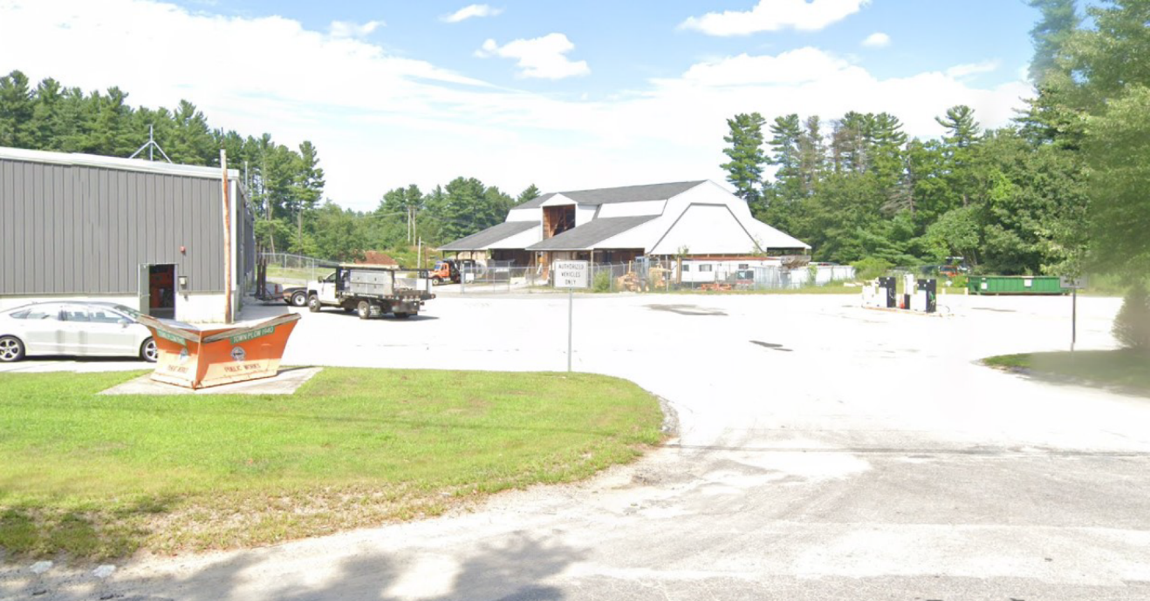
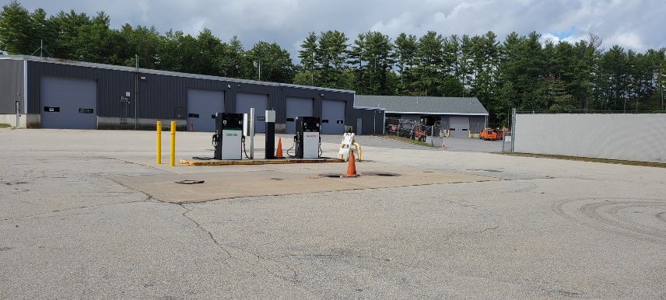
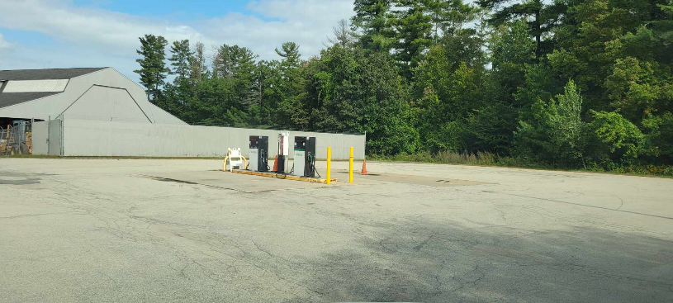
Highway department fuel tank, piping and canopy replacement
PWD CIP
FY 24 – 30
The fuel tanks located at the Highway Garage were installed in 1997 and are in need of replacement. These tanks are used by all of the Departments in Town that have vehicles. The fuel tanks have a thirty year life span which would be in 2027. At this time, NHDES is strongly suggesting that the type of piping that we have installed (model PP1501) be replaced sooner rather than later due to its tendency to deteriorate. The pumps and control system where replaced in 2019 and can be reused. This project would include replacing 2 – 10,000 gallon fuel tanks, all piping, concrete apron and canopy installation.

Slide 19
WWTF Major Projects

Slide 20

Sewer Relocation under Everett Turnpike
PWD CIP
FY 24 – 30
This project was known in previous CIPs as the Executive Park Drive Pump Station. NHDOT is working toward widening the two-lane sections of the F.E.E.T. in Merrimack – as part of that project they are replacing the concrete box culvert that carries Naticook Brook and our sewer pipe under the Turnpike. By coordinating our project with the NHDOT work we can provide a new crossing under the turnpike outside of the brook at a cost similar to or less than the pump station concept. The gravity pipe will eliminate the maintenance requirements associated with a pump station. Estimated cost to construct this project independent of the NHDOT work is $500,000.

Slide 21
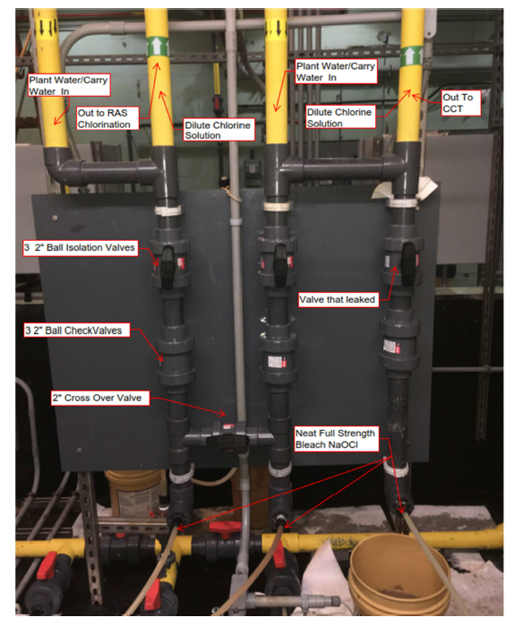
Hypo Feed System Upgrade
PWD CIP
FY 24-30
WWTP disinfects the final effluent from secondary biological treatment process using an industrial strength bleach (15% solution sodium hypochlorite).
The current system was constructed in a 1999-2000 facility upgrade.
Project Components to include:
  Replace two chemical storage tanks (3,000 gallons each, using high-density cross-linked polyethylene).
  Replace pumps and PVC piping.
  Reconfigure the system to include pressure relief values to relieve off gassing from the decomposition of sodium hypochlorite which produces oxygen in the form of bubbles and to meet current safety requirements.
The cost of $250,000 is a place holder for the project.

Slide 22
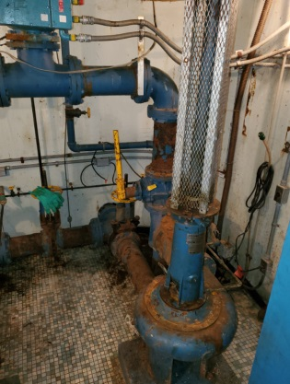
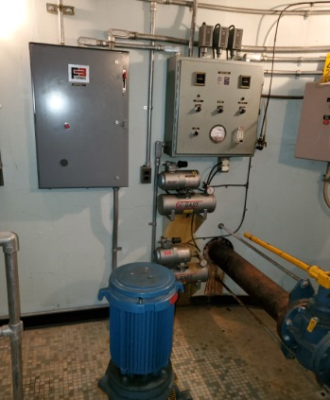
Pennichuck Square Pump Station Upgrade
PWD CIP
FY 24-30
The life expectancy of the pump stations is 20-30 years. Upgrading each of the pumps stations below will include replace pumps, controls, and alarm system.
Pennichuck Square Pump Station - The station was built in 1972. The station is now 50 years old and all the components have begun to fail.
Estimated Upgrade Cost – 1.5 Million
  $50,000 for engineering design
  $1,450,000 for construction

Slide 23
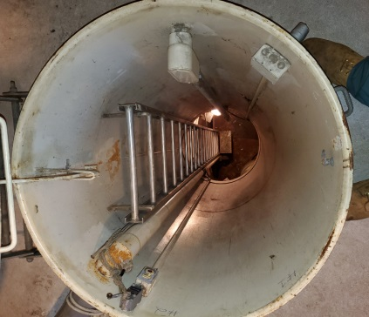
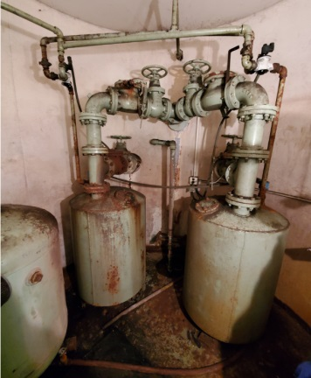
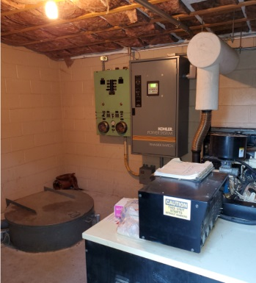
Burt Street Pump Station Upgrade
PWD CIP
FY 24-30
The life expectancy of the pump stations is 20-30 years. Upgrading each of the pumps stations below will include replace pumps, controls, and alarm system.
Burt Street Pump Station – This station is 44 years old and uses ejector pumps to pump sewage. The station will be upgraded to current technology which will likely include submersible pumps.
Estimated Upgrade Cost - $500,000
  $25,000 for engineering design
  $475,000 for construction

Slide 24
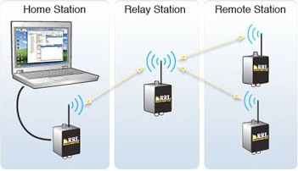
Telemetry Upgrade
PWD CIP
FY 24-30
The nine remote wastewater pumps stations communicate to WWTF via a combination of radio telemetry and cellular systems.
Six pump stations communicate to the WWTF via radio telemetry. The three remaining pump stations communicate to the WWTF via cellular data plans.
The design for the telemetry upgrade for the remaining pump stations is included in CIP ($25,000). Actual upgrades will be included with the individual pump station upgrades.

Slide 25
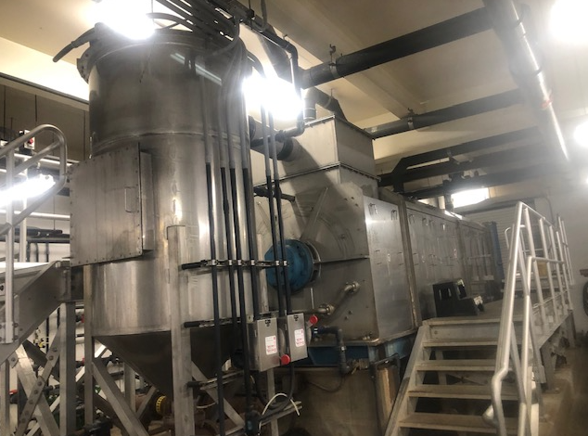
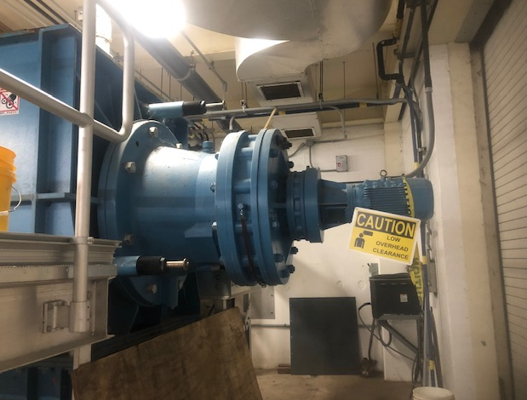
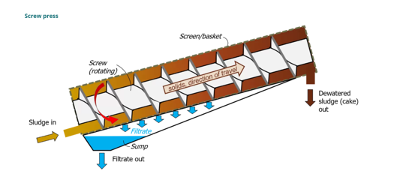
Dewatering System Screw Press Gear Box Replacement
PWD CIP
FY 24-30
The screw press is a very simple, slow-moving mechanical device used to dewater sludge.
Dewatering is continuous.
The gears in the gear box are used rotate the screw.
Oil samples are collected from the gear box to assess the integrity of the metal components.
Based on recent oil analysis of the gear box it appears that the metal components are starting to degrade which signals replacement of the gear box will be required.

Slide 26
Major Projects General Fund –
Future years

Slide 27
Major Projects Funding Sources (expenses)

Slide 28
Minor Projects

Slide 29
Minor Projects (expenses)

Slide 30
Minor Project Continued (expenses)

Slide 31
User fee Minor Projects Cont. (expenses)

Slide 32
User fee Minor Projects Cont. (expenses)

Slide 33
Minor Projects Funding Sources

Slide 34
Questions/Comments

Slide 35
Major Projects 2027-2030

Slide 36
Bridge Repair – Chamberlain Bridge Over Souhegan River
(DW Highway)
PWD CIP
FY 24 – 30
Chamberlain Bridge over the Souhegan River on Daniel Webster Highway (#116/120) was constructed in 1921 and Reconstructed in 1934. The stone/concrete arch bridge has a 2 arches and a total span of 113 feet. The US 3 bridge currently has a Federal Sufficiency Rating of 28% and a National Bridge Inventory Status of structurally deficient. The bridge has been categorized as a red list bridge.
The bridge is expected to be in the State Bridge Aid Program in which NHDOT pays for 80% of the cost of the project, while the Municipality pays the remaining 20%. Currently the State is not accepting new applications.
This bridge has a maximum span of 60 feet over the Souhegan River. The length of the bridge is a total of 113 feet and 42 feet wide with a curb to curb travel lane width of 32 feet. Part of the repairs will be completed within the Souhegan River Trail project. The Main Arch will be rehabilitated including masonry repointing and some concrete patching.
The 2019 AADT (Average Annual Daily Traffic) for this bridge is 13,596.
View of Souhegan River –
Down stream.
Chamberlain Bridge, upstream side.
Canal for Multi-Use Path

Slide 37
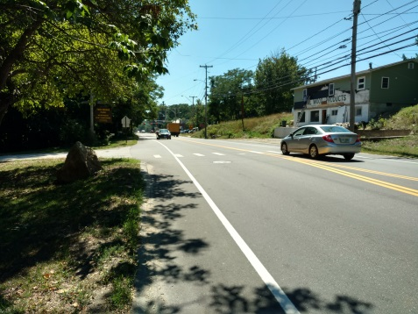
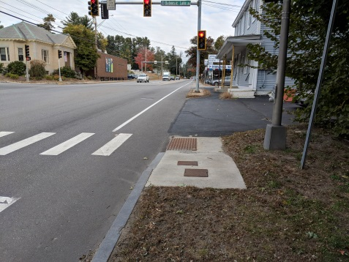
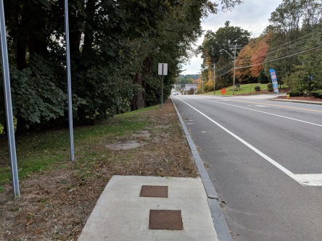
Sidewalk IMPROVEMENTS
PWD CIP
FY 24 – 30
The Town Center Pedestrian and Trail Master Plan has outlined many areas within the Town Center that are in need of sidewalks. Many sidewalks from the original plan have been or are being incorporated into future NHDOT FE Everett Turnpike Plans or the NHDOT 10 year plan.
The Town Center Committee recently updated their priority listings for the remaining items on the original listing. The top priority of the TCC is a sidewalk on Baboosic Lake Road from the Library to O’Gara Drive.
The second priority is a sidewalk on the west side of Daniel Webster Highway from Twin Bridge Road to the Post Office. The Third priority is on the East Side of Daniel Webster Highway from Classic Gas Station to Baboosic Lake Road.
The last priority for the TCC is the construction of a sidewalk on Twin Bridge Road which is a key part of the completion of the loop trail from Twin Bridge Park to Twin Bridge Road and back to the MYA facility.
Other priorities of the TCC include sidewalks along O’Gara Drive which the school has in their future planning, as well as Continental Boulevard.
Daniel Webster Highway – MYA
DWH@ Baboosic Lake Rd Crossing
DWH towards Loop Rd

Slide 38
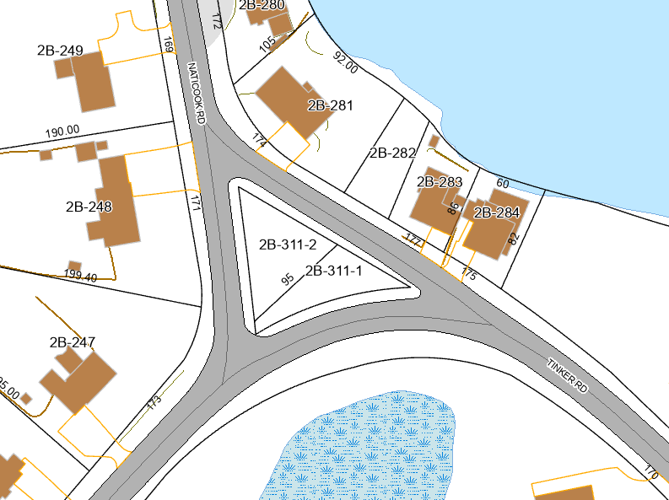
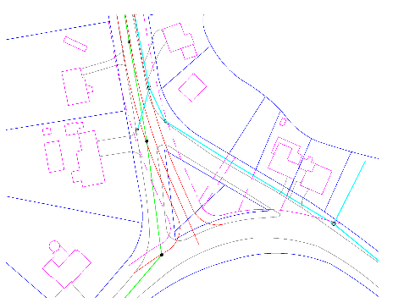
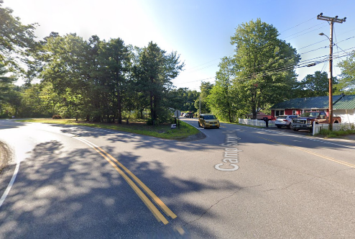
Naticook road triangle drainage and road Improvements
PWD CIP
FY 24– 30
The Merrimack Highway Safety Committee has put in their recommendation that the triangle at the intersection of Naticook Road and Camp Sargent Road be eliminated and that a tee intersection be constructed.
The neighbors have many safety concerns for themselves and their children about the speed of the traffic, lack of turn signals, poor visibility and the fact that they don’t obey the stop signs and continue without stopping.
The project will involve the approval of the Town Council for the un-dedication of sections of the existing road and the acquisition of land for the tee intersection.
The project will also involve repairing the drainage lines that have been failing since they are metal pipes and the possible turning lane(s) onto Naticook Road.
Birdseye view of Triangle Intersection
Concept Drawing for new Intersection.
Street view of intersection - approaching from Camp Sargent

Slide 39
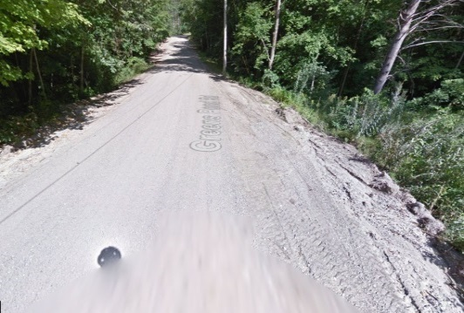
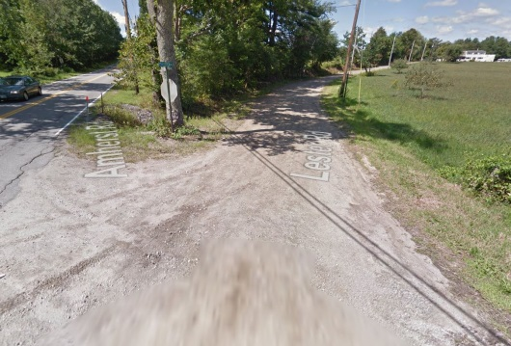
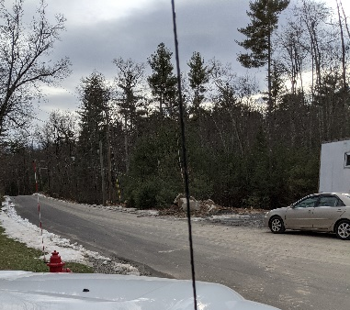
Paving / Infrastructure Improvements Gravel Roads
PWD CIP
FY 24 – 30
Merrimack has 16 gravel roads. Grading and reshaping the gravel roads uses approximately 300-400 man hours each year. Public Works proposes to systematically pave the gravel roads to reduce the maintenance burden. By constructing the paved roads with proper ditchlines, the effect of the added impervious area will be mitigated by treating the stormwater. The paved road has the added benefit of not being susceptible to erosion that contributes to silty runoff into neighboring waterbodies.
A secondary goal of this program is to eliminate the need to replace the motor grader. Currently, the existing 1997 grader is scheduled to be replaced in 2027 at an estimated cost of $300,000.
The roads initially targeted in this program are:
Fuller Mill Road
Lester Road
Greens Pond Road
The Chestnut Hill development project improved Old Blood Road from gravel to paved surface in 2020 (see photo to right). This section of Old Blood Road was accepted in 2022.
Greens Pond Rd – note erosion to the right
Lester Rd – will include realigning the “Y” intersection to a “ T” intersection

Slide 40
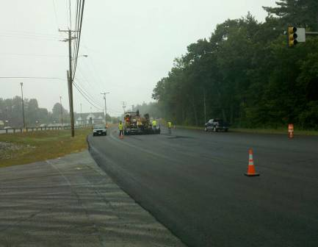
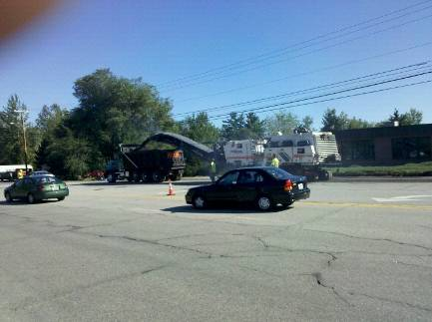
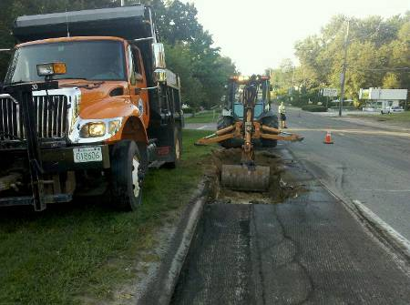
Paving Daniel Webster Highway
PWD CIP
FY 24 – 30
The Town of Merrimack is responsible for maintenance on the Class IV section of Daniel Webster Highway which runs from Greeley St to Bedford Rd, a distance of approximately 4.9 miles.
In 2011, the Town rehabilitated the section from Greeley St to the Chamberlain Bridge over the Souhegan River. In 2015, the Town repaved the section from the Chamberlain Bridge to Reeds Ferry Lumber. Both projects involved the expense of milling off the old wearing course of pavement and replacing with a new 1 ½” wearing course. The work planned in upcoming years includes continued crack sealing and bonded wearing courses in place of more expensive overlays as a more cost effective treatment aimed at keeping the road in good condition before more costly rehabilitation methods are needed. In 2019 the entire length of Daniel Webster Highway was cracked sealed. In 2023 the plan will be to place a bonded wearing course on the southern section to preserve the existing pavement thus “keeping the good roads good”. The northern section is scheduled for 2027/28. The middle section will be scheduled after the Baboosic Brook Bridge Construction.
The latest traffic counts along the corridor range from 12,000 to 16,000 AADT.
DW Highway Paving
DW Pavement Grinding
DW Repair Prior to Paving

Slide 41
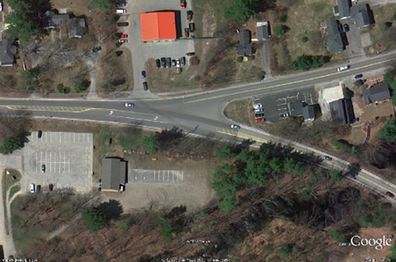
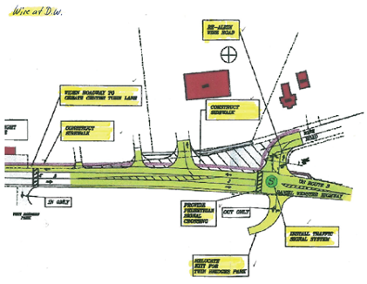
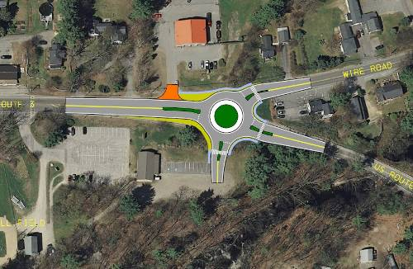
Wire Road Intersection Improvements
PWD CIP
FY 24 – 30
The Wire Rd intersection with Daniel Webster Highway is poorly aligned. This project will improve safety by realigning the intersection.
There have been 25 accidents in the area between Baboosic Lake Road to Twin Bridge Road from the period of January 1, 2017 to June 2022. Of those, 6 were at the Wire Road Intersection and one involved a bicycle accident was reported on Wire Road.
Various options will be considered: Sharp curve to align Wire road at a 90 degree angle to Daniel Webster Highway with traffic signals or stop sign (depending on the signal warrant study), or a roundabout intersection. As part of the project, a new point of ingress/egress to the Twin Bridge Park/Bise Field/MYA Building facilities that would improve safety versus the existing drive.
The project is currently in the NH DOT 10 year plan and payment will be an 80/20 split (Federal $/Town $). Construction of the intersection is being moved up to 2025 to coincide and be joined with the US Route 3 bridge project as they will influence one another.
Aerial View of Wire Road/DW Highway Intersection.
Signalized Intersection.
Roundabout Intersection.

Slide 42
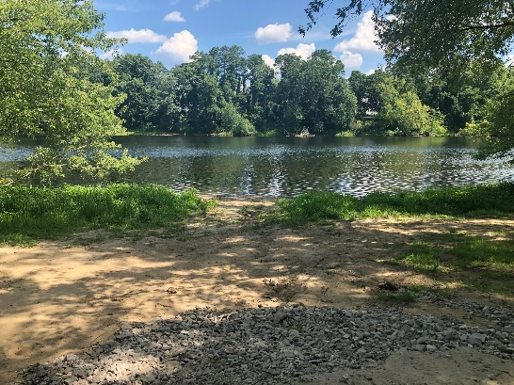


Merrimack River Boat Ramp Access Improvement
PWD CIP
FY 24 – 30
Access to the Merrimack River for larger, recreational boat use is currently difficult or not possible due to the limitations with the Griffin Street boat ramp and ramp access. The State Fish and Game Department has stated that funds to provide boat ramp improvements will not be provided at this location.
Cost estimates for the project are currently more than $700,000. Public Works recommends deferring this project and recommending educating the public on the existence of a new boat launch at Greely Park in Nashua.
There are several limitations to using the Griffin Street boat ramp beginning with the turn onto the access road from Griffin Street. It is very sharp and with a truck and trailer it is extremely difficult to make the turn. The access under the overpass is very narrow and
Boat Launch Area
Existing access off Griffin St.
Railroad Underpass Access

Slide 43



Seaverns bridge slope stabilization
PWD CIP
FY 24 – 30
At the intersection of Seaverns Bridge and Amherst Road where the existing canoe launch is located, the banks of the Souhegan River are eroding into the river. In order to preserve the banking, slope stabilization needs occur to prevent any further damage before it reaches and impacts the road infrastructure. The canoe launch will be incorporated into the stabilization.
Original Bridge Plaque
Proposed access & ramp area
Concrete Barriers

Slide 44



Souhegan River Trail
PWD CIP
FY 24 – 30
The Town of Merrimack was awarded a grant opportunity through FHWA/NHDOT to construct a multi use trail that will connect Watson Park to the pedestrian bridge over the Souhegan River that is adjacent the Everett Turnpike bridge. The trail is proposed to run under the Chamberlain Bridge through the sluiceway and across the former impoundment area of the Merrimack Village Dam.
Included in the project will be repairs to the failed sidewalk on the northeast end of the Chamberlain Bridge and repair of a concrete support beam for the Chamberlain Bridge.
The project has design a boardwalk across the former impoundment area as required by NHDES. NHDES Wetlands Bureau has granted a Wetland and Shoreland Permit approval for the project. Due to the size of the wetlands disturbance the Town will be required to pay compensatory mitigation for the permanent impact to the wetlands.
The project will be put out for construction bids in September 2022. Construction will begin in November 2023.
Historic view of sluiceway and headgate
Typical Boardwalk Section
Failed sidewalk on DW Hwy

Slide 45



Daniel Webster Highway Sidewalk Chamberlain Bridge to 360 plaza
PWD CIP
FY 24 – 30
In March 2021, The Town of Merrimack applied for a grant through FHWA/NHDOT to construct sidewalks along DW Highway from the Chamberlain Bridge south to near the 360 plaza. The project will allow the Town of Merrimack to continue to achieve sidewalk priorities as outlined in the 2009 Town Center Pedestrian and Trail Master Plan.
The Town has been notified that our application scored well and the project will be included in the draft NHDOT Ten Year Plan. The Town of Merrimack’s project achieved a ranking of 8 out of the 34 applications received State wide. Since the Transportation Alternatives Program (TAP) has been incorporated into the State of New Hampshire Draft Ten Year plan, the plan won’t be finalized until there is approval by the Governor and Legislature in June 2022.
Funding for the project, once approved, will become part of the 2023-2032 State of NH Ten Year Plan and will have funding starting in October, 2022 (Federal Fiscal Year 2023). The engineering for the project can begin in 2023 and construction is not scheduled until 2032 according to the 10 year plan (possibility to advance).
DWH at Chamberlain Bridge
West side DWH – new sidewalk area
DWH at 360 Plaza

Slide 46



Sewer Extension Project – Master Plan
PWD CIP
FY 24 – 30
The Town commissioned an updated sewer master plan in 2013. This plan replaced previous plans that were created in 1977 and 1990. The top priority project (Naticook Lake East Collector Sewers) was completed in 2015.
The Master Plan ranks projects based on a number of factors including impediments to onsite sewage treatment, access to existing collection system, environmental concerns, consistency with community master plan and unit costs.
The Mayflower Dr Collector Sewers project (MP Priority #3) would allow for approximately 43 homes to hook up to sewer. The project involves constructing approximately 2,400 linear feet of 8 inch diameter collector sewer. The roads in the area are in poor condition (Powderhouse and Minuteman – PCI of 31; Pilgrim and Mayflower – PCI of 54 and 54).
The McQuestion Rd North Collector Sewers project (MP Priority #2) would allow for approximately 44 homes to hook up to sewer. The project involves constructing approximately 6,400 linear feet of 8 inch diameter collector sewer in parts of McQuestion Rd, Meadow View Ln and Merrymeeting Dr.
Naticook Lake East Collector.
Mayflower Dr Collector.
McQuestion Rd Collector.

Slide 47

Depot Street Boat Ramp Repairs
PWD CIP
FY 24 – 30
The Depot Street boat launch provides access for smaller boats and canoes (hand carried) to access the Merrimack River. The access to the boat ramp is located on Depot Street where there is a parking area, a park area, and a box culvert tunnel under the railroad tracks containing a path to the river.
The end of the access has become badly damaged due to the currents of the river. Much of the stones and soils that comprised the end of the access have been washed away. Repair options are limited to machinery and materials that can fit through the box culvert as the railroad tracks prevent other access routes.
Design of the repairs to the ramp are proposed to occur in 2022 with construction proposed to be in 2022. State wetland permits will be required as part of the design process and construction will need to be completed during low flow periods.

Slide 48
Athletic Fields
Explanation of Need: In 2010, the Town Athletic Fields Committee produced a report that said the Town was short 21 athletic fields to meet the current needs of the Community. Since that time, that need has only increased as more children have signed up for youth sports. While we've searched for new locations to build athletic fields there were no good options available to us that were viable until now. Right now, our athletic fields get used pretty much 7 days a week from April thru November and as a result are often beat up and in fair to poor condition. We have been working with the various field users for a number of years trying to find options to building athletic fields and there have not been a lot of great options. Many of the Town owned sites are expensive to build on, sit on ledge, and have a lot of water on the site among other issues.
With the Town having now taken possession of the Greenfield Farms site off Pearson Road; we now a viable option for new athletic fields. Town Engineer Dawn Tuomala has drawn up a set of plans to see what we could fit on this particular site. What she found is that we can potentially fit two athletic fields along with the associated parking on the site. The first field would be a multipurpose full sized field for soccer, lacrosse and field hockey which would measure 195 ft x 330 ft. The second field would be a small soccer field which measures 135 ft x 195 feet. There is some wetlands that run thru the middle of the property which will require some wetlands permits and alteration of terrain permits that we will need to obtain the State of NH take time and have an expense associated with obtaining them.
This project would address a significant need that the community has been facing for a long time. Town Engineer Dawn Tuomala has provided current estimate for 2 athletic fields along with parking for 70 cars is $810,000.
With that said, there is the opportunity to apply for a Federal Land & Water Conservation Fund grant which could cover up to 50% of the cost of the total project. It would come with a requirement that this new park remain open to both residents and non-residents however that shouldn’t be an issue since we don’t have any residency restrictions on any of our other athletic fields.

Slide 49


Pearson Road Pump Station Upgrade
PWD CIP
FY 24 – 30
The life expectancy of the pump stations is 20-30 years. Upgrading each of the pumps stations below will include replace pumps, controls, and alarm system.
Pearson Road - This station is 30 plus years old and components are beyond their useful life and some components have begun to fail. The Town of Bedford is responsible for 90% of the Upgrade Costs.
Estimated Upgrade Cost - $250,000
  $25,000 for engineering design
  $250,000 for construction

Slide 50


Heron Cove Pump Station Upgrade
PWD CIP
FY 24-30
The life expectancy of the pump stations is 20-30 years. Upgrading each of the pumps stations below will include replace pumps, controls, and alarm system.
Heron Cove – This station is 30 plus years old and components are beyond their useful life and some components have begun to fail.
Estimated Upgrade Cost - $200,000
  $20,000 for engineering design
  $180,000 for construction

Slide 51




Compost Agitator Upgrade
PWD CIP
FY 24-30
Upgrade wireless communication between the Agitator and Dolly PLCs. Cost of upgrade $71,750 for each agitator (Total $143,000) - Complete FY 22/23
Reasons:
Safety – slip trips fall, having to climb over compost to reset agitator, possible exposure to toxic gases
Reduces time for operation activities. Improves consistency of operation.
Reduces trouble‐shooting time. Reduces service trips required of BDP.
Produces valuable process information which can be used to improve operation.
After the upgrade all the significant wear items will have been replaced and with the like new plc upgrade the machine will operate as a like new machine and be considerably safer for the operators

Slide 52


Nutrient Removal Upgrade
PWD CIP
FY 24-30
EPA has recently imposed nitrogen monitoring requirements and lower phosphorous limits to municipal wastewater treatment facilities which discharge to the Merrimack River.
Based on discussions with EPA both a nitrogen and lower phosphorus limit may be imposed in the future.
The cost of $250,000 is a place holder for the next NPDES permit cycle to complete a design project if nutrient removal is required.

Slide 53




Compost Blowers
PWD CIP
FY 24-30
CIP Minor 5 year project.
75 Blowers installed in 1994 when Compost Facility was built.
Blowers are essential to Compost Operation.
Blowers are beginning to fail.
  Extremely corrosive environment.
  Beyond useful life.
Purchased 15 Blower FY22/23
Replace 15 blowers per year for next 4 years.
Cost per year $33,000.
Notes:
(ammonia and moisture)
Ammonia–at high temperature has high potential for ni
Bearing and motors are failing from the dust generated in compost facility. The housing of the blowers are starting to rust because of ammonia and moisture at elevated temperature. We have rebuilt a number of blowers and replaced 2.
triding metals. ... Condensed ammonia is a corrodent, and in anhydrous state it can cause stress-corrosion cracking of stressed carbon steels or high-strength, low-alloy steels. Hydrogen–in itself not corrosive but can lead to blistering and embrit- tlement of steel. Fan blades aluminum.
Ammonia. ... Impurities in liquid ammonia such as air or carbon dioxide can cause stress corrosion cracking of mild steel. Ammonia is highly corrosive towards copper and zinc.

Slide 54






Phase VI / VII Wastewater Facility Improvements
PWD CIP
FY 24-30
The total cost for the Phase VI / VII Upgrade is estimated at $15.0 million.
This will include upgrading or replacing items that were installed in 2006 during the Phase I upgrade; Rotary Drum Thickeners, Odor Control System, Septage Receiving Unit and Building. Other identified items as part of these upgrades will address, original civil work not covered in the Phase III-V upgrade; valves and lines on the Aeration Tanks, Equalization Tanks and Primary Tanks, a rebuild of the compost Bio-filter and a third Agitator. Upgrades to the electrical MCC’S at Compost and in the Headworks building and other original 120v /130V electrical systems. We will also look to address needed modifications of the Aeration system to meet an anticipated more stringent nutrient limit; a third Aerzen Blower, Nitrate Recycle pumps, control gates and valves.

Slide 55
Minor Projects back-up

Slide 56
Wasserman Park Beach Phase IV
Explanation of Need: In Spring 2022, we completed the first phases of the Beach Renovation Project at Wasserman Park which dealt specifically with the right hand side of the beach as you are looking at the water (to the right of the 3 big pine trees) by building a perched beach and excavating all the mud and muck out of the unusable swimming area.

Slide 57
Skateboard Park Replacement
The current Skate Board Park on O'Gara sits on land that is owned by the Merrimack School District. We are currently on a year to year lease of that land and at any point the School District could choose not to extend the lease and so we are trying to be prepared. Even if the Park remains where it is; the equipment is old and out of date and needs to be replaced. Our existing skateboard park has a wooden sub frame to it and considering the age of the structure, we are not confident that once we take it apart, we will be able to put it back together again and still have it be a solid and sturdy structure. Right now we’re spending about $4,000 every year and a half to two years replacing panels on the existing park. One of the reasons for this is because of the weight of the two quarter pipes that we have in our existing park. Being on an asphalt pad, the corners of the quarter pipes sink a little into the asphalt during the summer which then causes the individual skate lite panels to crack. Modern skatepark equipment is more durable and we would look to build the park with a concrete bases under the heavy equipment as opposed to asphalt to avoid the sinking issue we currently have. To replace the equipment that we have with modern skate park elements the estimate is $150,000 if the park is in the same location. If we need move the park to a different location and create a base from scratch, we are looking at an additional $24,700 for a new base surface for a total cost of $174700

Slide 58
Wasserman Park Road Improvement
We are looking to repair the Wasserman Park Road System as well as improve parking within the Park. The Park road system has been slowly deteriorating over the last 4 – 5 years with the increased amount of traffic that is utilizing it particularly on the road that leads down to the Waterfront Parking Lot that was created in 2015. In summer 2021; we experienced torrential rain storms on a nearly weekly basis; which has caused significant damage to the park road system as it keep washing away and we end up with 12” deep holes along the roadway which someone is going to step in and get hurt. Public works was out 5-6 times since last year trying to patch the roadway and repair the washouts, but we’ve gotten to the point where we need a more permanent solution. The Park road itself was never built for the amount of traffic it gets and it’s not wide enough for proper emergency vehicle access. From the Parks & Recreation Office down past the tennis courts it is currently setup for two-way traffic. In theory, if a car coming down the hill sees someone coming up the hill, they are supposed to yield near the Parks & Recreation Office until the other vehicle passes. In reality what happens is that don’t yield and instead they drive up onto the grass on the edge of the road to pass each other. As a result, this causes the edges of the roadway to further buckle and crack.
For this project, we would like to widen the entry road to 16 feet (Per DPW recommendations) from the entrance to the park, down to the Parks & Recreation Office where it would widen to 20 feet from this point down past the tennis courts which has two way traffic on it. We would then loop back up past the Function Hall with a 16” foot wide road straight out to the park’s exit. This portion of the project will fix the deteriorating roads build in some curbing as well as address some of our water runoff issues by improving access to draining. For this portion of the project Public Works Director Kyle Fox has estimated $200,000.
The second part of this project is to improve parking and access to the park’s amenities by building an additional parking lot above the basketball courts (near the Function Hall) for easier access to the Function Hall, Playground & Sports Fields. This past year; we generated nearly $10,000 in revenues from renting out the Function Hall between September – May. If you are attending an event at the Function Hall and you’re all dressed up; currently you have to park in the parking lot behind the Parks & Recreation Office or down a steep hill from the Parking Lot by the Dog Park. Walking across the lawn in heels for example is not ideal and creates a safety hazard with the loose gravel and uneven rocky terrain. Many of these events are taking place at night and while we have some lighting on the roadway, it’s not enough to clearly see by. If you’re a parent taking your kids to the playground or to Football practice, we get constant complaints about the length of the walk. In the winter months, it makes using the Function Hall nearly impossible after any snowstorm because even when we tell people not to drive down the hill; they do it anyway, and then they get stuck.
What I would like to do is create a parking lot where the old MYA Cabin used to be (above the basketball courts) to create a specific parking lot people are allowed to legally park and eliminate the above issues. We have the room to create a parking lot with approximately 30 parking spaces in this otherwise unused space. In a meeting with Public Works Director Kyle Fox; he has given me an estimate of $30,000 for this portion of the project.
The total project combined would be $230,000.

Slide 59
Replacement of Martel Field Lights & New Lights at Greenfield Farms
The current field lights on Martel Softball Field are 20+ year old and 3 out of the last 4 years, we have had individual light fixtures keep breaking. Part of the challenge in repairing the lights is that the current poles are taller than the Town's bucket truck can reach and so when repairs are needed; the Town not only has to schedule the time with the electrician to come in but also has to coordinate that time to rent a taller bucket truck to reach the lights. This process often takes weeks to complete before the repairs can be made and teams are then playing with fewer lights creating a safety issue. The lights are nearing the end of their lifespan and so we are recommending replacing the lights with modern equivalents; which are more energy efficient. The second issue that we have with the existing light towers is that the lights are too short for Adult Softball to begin with. The current lights are on telephone poles, which are 40 feet tall, but for Adult Softball; which plays on that field, the light towers should be at least 50 feet tall to provide proper lighting and visibility of the field. Kyle Fox obtained an estimate for a total of 20 lights spread out between 8 lights poles of 350 LED Sports Lighting at a cost of $76,000, but factoring 30% for inflation costs; our revised number is $98,900. Martel Field is one of only 3 fields in Town which has lights on them to begin with and is the only adult softball field with lights. New lights would be modern LED lighting which would provide better coverage and visibility and actually reduce ambient light off the field reducing the impact to the neighborhood. Since they would be LED lights, there should also be a significant savings on electricity.
The second part of this project would be to add lights to the 2 new multipurpose fields at Green Field Farms. At these fields we would only need 40 foot light towers since the fields wouldn’t be used for baseball or softball and so it is less expensive per field and we would be looking at an estimated cost of $146,000 per field tor a total of $292,000 to put lights on both fields. Lights would significantly increase the availability of the field which are always in high demand and we have such a tremendous shortage. Bidding light projects should generate some savings on the bids as opposed to doing them one at a time and new lights come with a 25 year warranty on parts and labor. There is already a line item in the FY 25-26 budget for 1million dollars as a bond project. The total cost for lights at the 3 field would be $390,900. With this project, there is the potential to obtain a matching grant from the Land & Water Conservation Fund for up to 50% of the total cost . which would further reduce the cost of this project.

Slide 60
Function Hall Basement Retrofit
In 2016, we added a brand new heating system, windows, insulation and a permanent water line were added to the Function Hall building which allows the building to be used on a year round basis. There is approximately 2500 square feet of unfinished space in the basement which has framing in place already for a series of smaller meeting or activity rooms. Right now, we can only have one activity at a time taking place in the building because there is no way to segment off the rooms upstairs.
We are looking to finish the basement space by adding flooring, sheet rock and paint on the walls and a drop ceiling. This will create five or six individual meeting/activity rooms, bathrooms and separate storage areas which can be secured. The basement already has plumbing installed and so we would also add in a restroom in the basement. The space also already has sprinklers, heating and electrical already installed. In order to make the space ADA Accessible, we would also need to either add a ramp to the side of the Function Hall building running down the side of the building or by removing the front entrance staircase and installing a lift in that space.
There are several benefits to finishing on the Function Hall basement. First, it gives us smaller meeting/activity rooms so that we could have multiple activities going on in the building at the same time. Secondly, unlike the individual cabins that are located throughout the park, the space can be used on a year round basis. We have 9 individual cabins throughout the park that can only be used for a few months of the year. These cabins are heavily used during the summer months for Recreation programs and are necessary for the Summer Camps operation, but they sit empty during the rest of the year. The main problem is that these rustic cabins are expensive to maintain. On average we spend $5000 - $7,000 per year maintaining these seasonal buildings and as they age it is getting even more expensive. If the basement of the function hall was finished space; then these cabins become less important to the summer programs as well as to provide additional meeting space. In the long run, it will save us money on maintenance costs while providing tremendous value. Based on other projects that we have completed over the last few years, I am estimating a need of $100,000 to finish off the basement into usable space

Slide 61
Wasserman Park Irrigation
We are looking to install an irrigation system onto the Football Practice field at Wasserman Park. This particular field is used by MYA Football who submitted the request to us and which 100 + people per night using the field 5 nights per week from August - November.
There is currently no irrigation here and due to the nature of football, by the Middle of August this field is more dirt than grass for most of the season. It has gotten to the point where the MYA is running a hose from the Function Hall all the way out to the field (over 1000 feet) to try and water down the field before each practice. The Town has also had the Fire Department bring a pump truck out to water down the field to try and cut down on the dust but the effects are limited. As the kids are playing there is a giant cloud of dust across the field; which make it a health hazard for the players and coaches. Unfortunately due to our field shortages in Town, there is no other alternative field location to move these practices football too.
We are looking to install an irrigation system so that the grass grows better and eliminates the issue. We have received an estimate of $50,000 from Stateline Irrigation who manages all of the irrigations systems on the other athletic fields in Town. We know that we may have an issue with ledge as well as increasing costs due to inflation between now and next year and so we are requesting $60,000 and then there will be the cost of the water which we are budgeting at $2,000 per year.

Slide 62
Voting Machines
The machines NH is currently authorized to use are older and have not been manufactured for several years. Many municipalities have had difficulty obtaining replacement parts when there are breakdowns as parts are becoming scarce. The SOS’s office anticipates that the legislature and the ballot law commission will approve a few different vendors for municipalities to use in the upcoming year or so. There is an expectation that municipalities will be given some time to secure funding to replace machines prior to the current machines becoming “unauthorized” for use. Municipalities that do not use machines hand count ballots. Hand counting is not something that would be practical for Merrimack.
Merrimack currently utilizes 3 machines per polling location for a total of 9 machines. Current estimated costs for new machines are between $6500 and $9000 per unit. As such, we should plan to add up to $81,000 to the CIP for the anticipated replacement costs.

