Slide 1
Merrimack Town Council
Public Hearing
February 12, 2026
Presented by:
Merrimack Town Council

Slide 2
Proposed Issuance of Debt

Slide 3
Compost Energy Efficiency Enhancements
Clean Water State Revolving Loan
    $500,000 with up to $250,000 principal forgiveness for Compost Energy Efficiency Enhancements.
    100 % paid by User Fees No impact on taxes
The estimated cost for this scope of work is $500,000

Slide 4
Purchase of Land
Purchase of +/- 61.4 acres (Tax Map 5D-2/010 & 5D-2/009)
  $1,900,000
  Current Land Bank CRF $492,815
Potential usage
  Safety Complex
  Athletic Fields
  Future Town Buildings

Slide 5
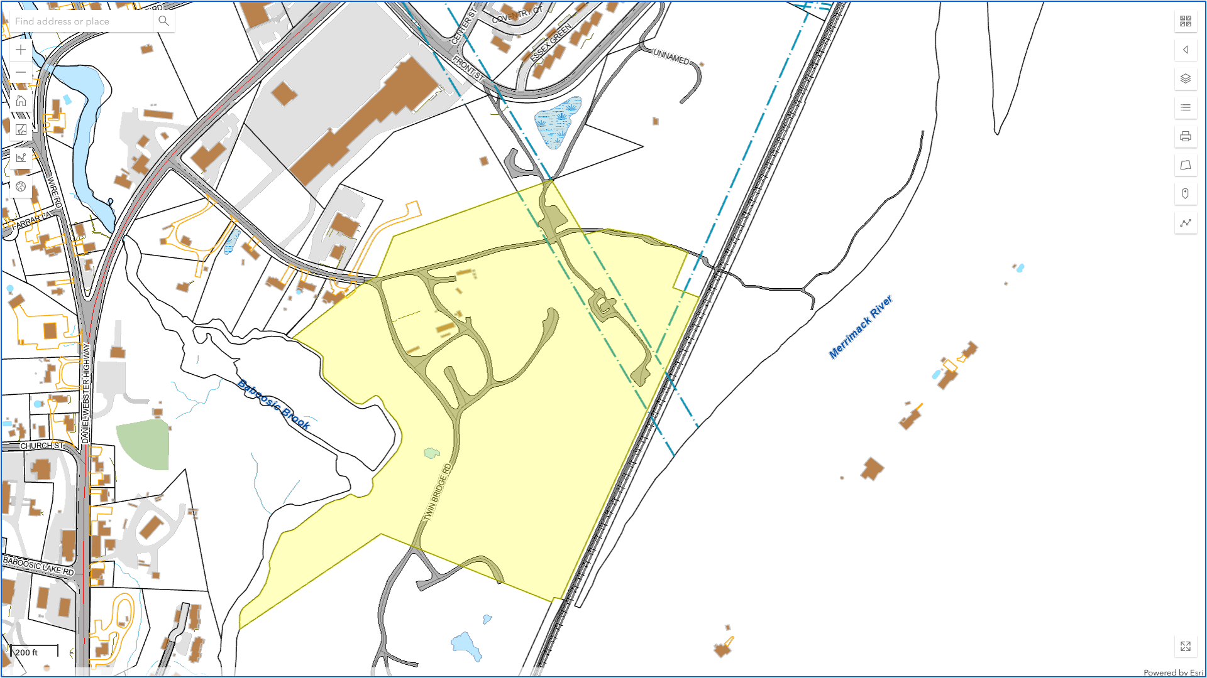

Slide 7
Proposed 10-year Repayment Schedule
Based on Single family home of $424,650

Slide 8
Proposed 5-year Repayment Schedule
Based on Single family home of $424,650

Slide 9
Budget Summary 2026-27

Slide 10
Terminology
Appropriation - The process where the Town authorizes funds for specific purposes, ensuring legislative control over spending.
Gross Appropriation - the total sum of all authorized funds in a budget, covering all funding sources for a particular purpose, program, or agency. It is the total budget authority before any deductions are made for reimbursements, interdepartmental grants, or intradepartmental transfers
To be Raised by Taxes – Appropriations minus Revenues
Tax Rate Formula -
(appropriations – revenues)/valuation = Tax rate
To be Raised by Taxes/valuation = Tax rate

Slide 11
Tax Rate 2025

Slide 12
Tax Rate 2025 Over $100 Million in Collections

Slide 13
Typical Bill for Assessed Value of $371,200 Home for 2025

Slide 14
Municipal Tax Bill Broken Down by Department ($1,626)

Slide 15
Municipal Tax Bill Broken Down by Department ($1,626)

Slide 16
Estimated 2026 Tax Rate Summary

Slide 17
Budget Highlights Cont.
Appropriations
  Dental/Short-term Disability/ Unemployment/Life
  Workers Compensation
  General Liability Insurance
  Asphalt Pile Grinding
  Uniforms
  Nashua Transit
  Special Handling
  Solid Waste Tipping Fees
    Recycling - $0
    Disposal – $ 48,850
$ 26,500
($ 4,000)
$ 65,700
$ 25,000
$ 23,300
$ 3,000
$ 33,900
$ 48,850

Slide 18
Budget Highlights Cont.
Elections
Telephone Service/Maint.
Printing & Postage
Maint. Buildings & Grounds
Maint. Machinery/Equipment/ Vehicles
Education & Training and Travel
Dues
  $ 15,700
  $ 15,000
  $ 7,300
  $ 46,250
  $ 7,500
  $ 24,000
  $ 7,500

Slide 19
Budget Highlights Cont.
Ammunition
Welfare Housing
Office Supplies
New K-9
Utilities (Water , Sewer Electric & Natural Gas)
Drainage Maintenance
Miscellaneous
Total
$ 25,000
$ 7,500
$ 10,500
$ 17,000
$ 3,200
$ 5,000
$ 64,057
$477,757

Slide 20
Budget Highlights Cont.
  NHRS
  Compensated Absences
  Union Wages (NEPBA 12, NEPBA 112 AFSCME 3657 & Teamsters)
  Overtime – Fire
  Overtime - Police
  Library Raises & staffing changes
  Nonunion – Performance Pay plan
  Staffing
  Full-time to Part-time
    Welfare Administrator
  Part-time to Full-time
    EMS Coordinator
  Total
$ 133,500
$ 78,600
$ 388,450
$ 8,900
$ 17,400
$ 19,700
$ 50,700
($ 78,900)
$ 39,600
  $657,950

Slide 21
Budget Highlights Cont.
Paving
Vehicles
  Police ($119,200)
TOTAL
Total GF Increase
$ 90,000
$ 5,000
$ 95,000
        $1,230,707

Slide 22
Budget Highlights Cont.
Savings
Health Insurance
Computer Supplies
Vehicle Fuel
Interest
Library Materials
Advertising
  Total GF Increase
$( 35,000)
$( 13,850)
$( 24,700)
$( 11,900)
$( 9,800)
$( 7,500)
      ($102,750)
        $ 1,127,957

Slide 23
Use of Fund Balance

Slide 24
Non-union Pay Raise and Additional Cost Cutting Measures

Slide 25
Estimated Budget Tax Rate after cuts

Slide 26
CRF Purchases
Change from prior years

Slide 27
Budget Highlights
Capital Reserve Fund (CRF) Purchases in 2026-27
No longer in Operating Budget

Slide 28
CRF General Fund Deposits

Slide 29
Budget Highlights
CRF Deposits

Slide 30
CRF WWTF Fund Deposit

Slide 31
Budget Highlights
CRF Deposits

Slide 32
Important Budget Dates
Deliberative Session
Wednesday, March 11, 2026 –- 7:00 pm
    James Mastricola Upper Elementary School All Purpose Room
Annual Voting Day
Tuesday, April 14, 2026 – 7:00 am – 7:00 pm
  Merrimack High School, 38 McElwain St.
  Merrimack Middle School, 31 Madeline Bennett Lane

Slide 33
Tax Rate Summary

Slide 34
Items that Affect the Tax Rate

Slide 35
Tax Municipal Rate break out

Slide 36
Default Budget

Slide 37
Default Budget Calculation

Slide 38
Default Tax Rate Comparison

Slide 39
Important Budget Dates
Deliberative Session
Wednesday, March 11, 2026 –- 7:00 pm
    James Mastricola Upper Elementary School All Purpose Room
Annual Voting Day
Tuesday, April 14, 2026 – 7:00 am – 7:00 pm
  Merrimack High School, 38 McElwain St.
  Merrimack Middle School, 31 Madeline Bennett Lane

